Slide 1
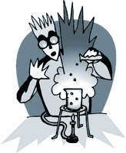
Lab Accidents are NOT funny!!
Michelle Dufault
Elizabeth Griffin and the Rhesus monkey
Remembering Karen Wetterhahn
Methanol accidents
Sheri Sangji
For each incident, in paragraph form:
Name, age, location of accident.
What caused the accident?
Was a lab safety rule was broken?
What injuries occurred?
How many people were injured?

