Slide 1
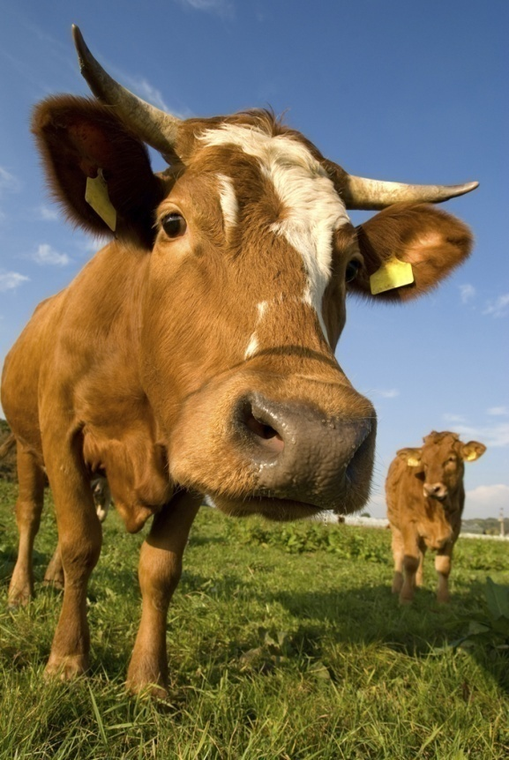
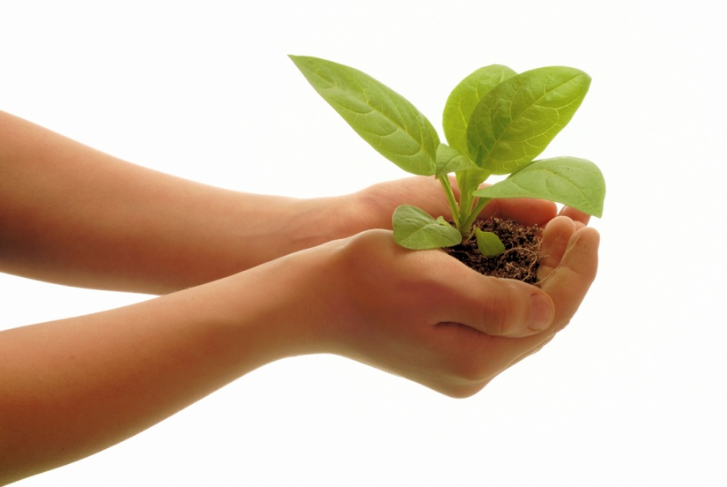
Photosynthesis & Cellular Respiration

Slide 2
What molecule is needed to start glycolysis?
Glucose

Slide 3
Chlorophyll and other pigments are organized into clusters known as
photosystems

Slide 4
How many ATP’s are produced from the Kreb’s cycle?
2 ATP’s

Slide 5
Name the three processes of cellular respiration.
Glycolysis
Kreb’s cycle
ETC (Electron Transport Chain)

Slide 6
_______ is an energy storing molecule
ATP

Slide 7
Where does the ETC occur in a cell?
INNER mitochondrial folds

Slide 8
How is energy stored in our cells?
ADP + Phosphate creates ATP – the energy storing molecule

Slide 9
Electrons leave Photosystem II and travel to Photosystem I by way of the
Electron Transport
Chain

Slide 10
What plant cell organelle is involved in photosynthesis?
chloroplast

Slide 11
Saclike photosynthetic membranes in the chloroplast are called
thylakoids

Slide 12
What are the starting molecules of the light reactions?
Sunlight
water

Slide 13
How is energy released when using ATP?
ATP is broken down into ADP + P; every time a bond is broken, energy is released!

Slide 14
When does our body use lactic acid fermentation
When exercising; that’s what makes you sore after working out

Slide 15
Why does our body use lactic acid fermentation?
When our cells are not getting enough oxygen for aerobic respiration to occur

Slide 16
Why is cellular respiration important?
Provides usable energy for our cells!

Slide 17
What is pyruvic acid (pyruvate) changed into during alcoholic fermentation?
Carbon dioxide
Ethyl alcohol

Slide 18
When yeast ferments the sugar in a bread mixture, what is produced that causes the bread dough to rise?
carbon dioxide

Slide 19
Light energy is converted to chemical energy during this stage of photosynthesis.
Light Dependent Reactions

Slide 20
How would you abbreviate Adenosine diphosphate?
ADP

Slide 21
What are the two stages of photosynthesis?
Light dependent reaction
Light independent reaction (calvin cycle)

Slide 22
Cellular respiration that does not require oxygen is called ____
Anaerobic Respiration

Slide 23
Cell respiration that requires oxygen is called ____
Aerobic Respiration

Slide 24
________ are organisms that make their own food (like plants).
Autotrophs

Slide 25
The “Powerhouse” of the cell is the ________
Mitochondrion; because
thats where food energy is released and becomes cellular energy (ATP)

Slide 26
What is the green pigment in plant cells called?
chlorophyll

Slide 27
_____ is the ability to do work.
Energy

Slide 28
What are the products of photosynthesis?
Glucose
Oxygen

Slide 29
What is the molecule that is directly used by a cell for energy?
ATP

Slide 30
Write the equation that represents aerobic cellular respiration?
C₆H₁₂O₆ + 6O₂ → 6CO₂ + 6H₂O +energy

Slide 31
What is the function of chlorophyll in the light dependent reactions?
capture light energy

Slide 32
What is the name of the following compound, C₆H₁₂O₆?
Glucose

Slide 33
What type of organism does lactic acid fermentation take place in?
animals

Slide 34
During fermentation, _________ are used to create the products of lactic acid fermentation and alcoholic fermentation.
pyruvates

Slide 35
What do cells use energy for?
Homeostasis
cellular movement (muscle cells)
eliminating wastes

Slide 36
Where does glycolysis occur in a cell?
cytoplasm

Slide 37
What are the product of the light reactions?
Oxygen
NADPH
ATP

Slide 38
Where does the Kreb’s Cycle occur in a cell?
mitochondrion

Slide 39
__________________ is the process by which autotrophs trap energy from sunlight to build carbohydrates
photosynthesis

Slide 40
During anaerobic respiration _______ ATP’s are produced.
2 ATP (from glycolysis)

Slide 41
In what organism does alcoholic fermentation take place in?
plants

Slide 42
What is the equation that represents photosynthesis?
6CO₂+6H₂O +light energy → C₆H₁₂O₆ + 6O₂

Slide 43
Most of the ATP produced during aerobic respiration comes from the ___________.
ETC (Electron Transport Chain)

Slide 44
The Kreb’s cycle produces ATP, NADH +FADH₂, and _____________
Carbon dioxide

Slide 45
Glycolysis produces, ATP, NADH, and ______________
2 pyruvates

Slide 46
How many ATP’s are produced from glycolysis?
2 ATP’s

Slide 47
The products of the ETC are ATP and ___________
water

Slide 48
____________ must be present in order for the Kreb’s Cycle and the ETC to occur.
oxygen

Slide 49
What are the starting molecules of the dark reactions?
Carbon dioxide
NADPH
ATP

Slide 50
How many ATP’s are produced from the etc?
32 ATP’s

Slide 51
Glycolysis does not require_______________ in order to happen.
oxygen

Slide 52
what is pyruvic acid (pyruvate) changed into during lactic acid fermentation?
Lactic acid

Slide 53
How many atp’s are produced from one molecule of glucose at the end of aerobic respiration?
36 ATP’s

Slide 54
What is the product of the dark reactions?
Glucose

Slide 55
What is the importance of photosynthesis?
Provides food for plants and without plants the entire ecosystem would die
Provides animals w/ oxygen

Slide 56
Study your notes and worksheets!!

