Slide 1
Periodic Table

Slide 2
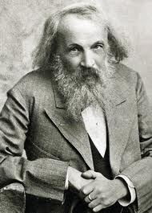
Mendeleev
Russian chemist
Designed the first periodic table of elements
Arranged elements based on atomic weight
Predicted the existence of new elements
A few elements (such as tellurium and iodine) did not fit the pattern

Slide 3
Modern Periodic Table
Rearranged by Henry Mosely about 40 years later
Elements listed by atomic number
Most did not change places, but the few that did were placed in columns with similar elements
This fixed the problems Mendeleev found with his periodic table

Slide 4
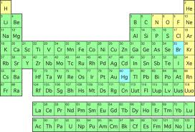
Periodic Table Arrangement
Period: a row of elements (across)
As elements go across a period, they become less metallic
Group: a column (up and down)
All elements in the same group share similar chemical properties

Slide 5
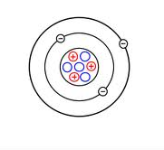
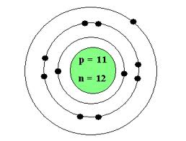
Electrons
Elements in each group have similar chemical properties
This is due to the fact that these elements have the same number of valence electrons
Ex: lithium and sodium both have one valence electron

Slide 6
Ion Formation
If an atom’s outer electron level is not filled, it may gain or lose electrons to have a full outer orbital
This results in an atom with a positive or negative charge (an ion)
Elements with just a few valence electrons will most likely lose them to form positive ions, while elements with many valence electrons will most likely gain electrons to form negative ions.

Slide 7
Classification of Elements
Metals (most elements)
Conduct electricity and heat, malleable/ductile, shiny
Nonmetals
Do not conduct electricity and heat, not malleable or ductile, not shiny
Semiconductors or metalloids
Have properties of both metals and nonmetals

Slide 8
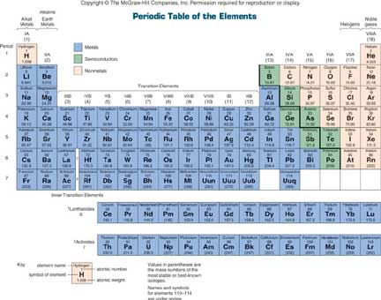
Metalloids: B, Si, Ge, As, Sb, Te, Po

Slide 9
Practice Questions
Which list of elements consists of a metal, a metalloid, and a nonmetal?
Li, Na, Rb b. Cr, Mo, W c. Sn, Si, C d. O, S, Te
Which element is malleable and can conduct electricity in the solid phase?
a. Iodine b. Phosphorus c. Sulfur d. Tin
Which element has both metallic and nonmetallic properties?
a. Rb b. Rn c. Si d. Sr
The elements in Group 2 are classified as
a. Metals b. Metalloids c. Nonmetals d. Noble gases
A sample of an element is malleable and can conduct electricity. This element could be
a. H b. He c. S d. Sn

Slide 10
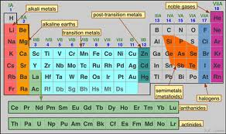
Element Families
Alkali metals (group 1)
Alkaline earth metals (group 2)
Transition metals (groups 3-12)
Halogens (group 17)
Noble gases (group 18)

Slide 11
Periodic Trends
Atomic radius
Increases down a family because electron levels are increasing
Decreases across a period
Why??
Atomic mass
Increases down and across the Periodic Table

Slide 12
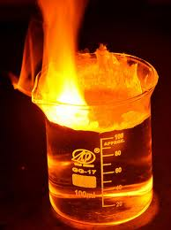
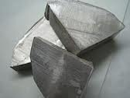
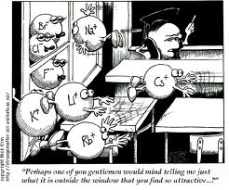
Alkali Metals
Group 1 (except hydrogen)
Very soft metals
Highly reactive
Have one valence electron

Slide 13
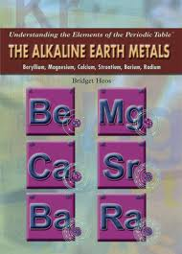
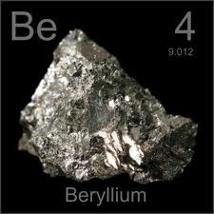
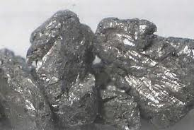
Alkaline Earth Metals
Group 2
Two valence electrons
Less reactive than alkali metals, but still react to form positive ions

Slide 14
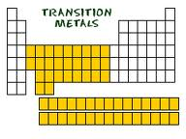
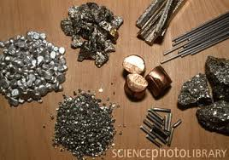
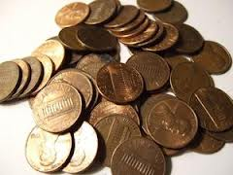
Transition Metals
In the middle of the periodic table
Much less reactive
Valence electrons vary
Complex electron arrangements
Can form positive or negative ions

Slide 15
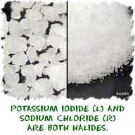
Halogens
Group 17
Seven valence electrons
Combine easily with alkali metals to form salts
Ex: NaCl

Slide 16
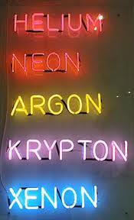
Noble Gases
Group 18
Outer electron levels are full
Called inert gases because they do not typically react to form compounds

Slide 17
Review Questions
Classify the following elements into families:
Iron, Fe
Potassium, K
Strontium, Sr
Platinum, Pt
Describe why chemists might sometimes store reactive chemicals in argon (Ar). To which family does argon belong?
Identify which element is more reactive: Li or Be.
Imagine you are a scientist analyzing an unknown element. You have confirmed that the element is a metal, but you do not know if it is an alkali metal, alkaline earth metal, or transition metal. Write a paragraph describing how you could further classify this metal.

