Slide 1
Modern Atomic Theory

Slide 2
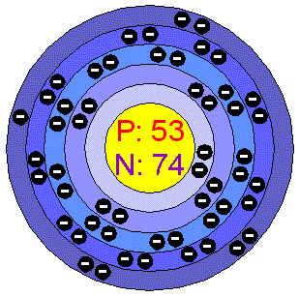
Bohr Model
Shows and number of protons, neutrons, and electrons
  Protons and neutrons inside nucleus
  Electrons outside nucleus

Slide 3
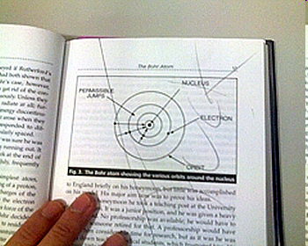
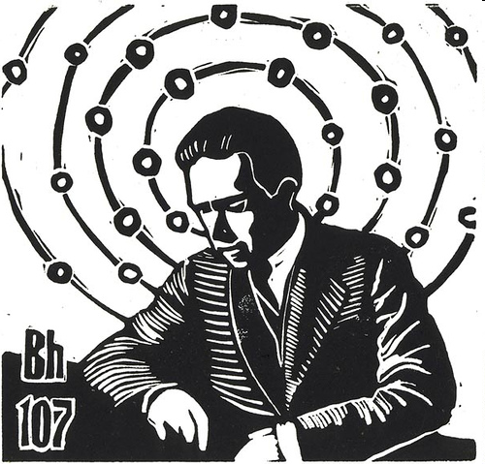
How to Draw Bohr Diagrams

Slide 4
Atomic Structure
Atoms have a nucleus that contains Protons and Neutrons
Electrons are contained in shells that surround the nucleus
An atom is made of mostly empty space
Protons have a positive (+) charge
Electrons have a negative (-) charge
Neutrons are Neutral

Slide 5
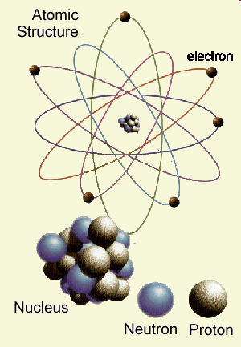

Slide 6
Valence Electrons
Each electron shell can hold a certain number of electrons
Electron shells are filled from the inside out
Noble Gases have full outer electron shells
All other elements have partially filled outer electron shells
Electron Shell | Number of Electrons
1 | 2
2 | 8
3 | 8
4 | 18
5 | 18
6 | 32
7 | 32

Slide 7
Valence Electrons
The electrons in the outer most electron shell are called valence electrons
The shell containing electrons that is furthest from the nucleus is called the valence shell
The number of electron shells with electrons is the same as (=) the period number
Atoms will try to gain or lose electrons to have a full valence shell

Slide 8
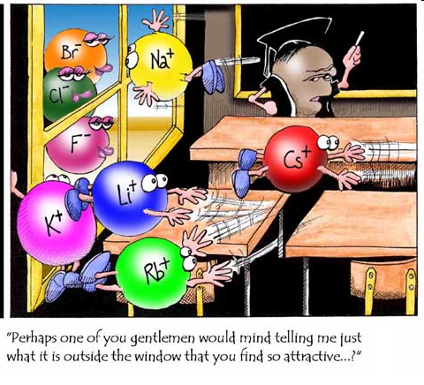

Slide 9
Bohr Diagrams
Find your element on the periodic table.
Determine the number of electrons – it is the same as the atomic number.
This is how many electrons you will draw.

Slide 10
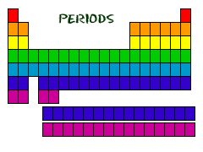
Bohr Diagrams
Find out which period (row) your element is in.
Elements in the 1st period have one energy level.
Elements in the 2nd period have two energy levels, and so on.

Slide 11
Bohr Diagrams
Draw a nucleus with the element symbol inside.
Carbon is in the 2nd period, so it has two energy levels, or shells.
Draw the shells around the nucleus.
C

Slide 12
Bohr Diagrams
Add the electrons.
Carbon has 6 electrons.
The first shell can only hold 2 electrons.
C

Slide 13
Bohr Diagrams
Since you have 2 electrons already drawn, you need to add 4 more.
These go in the 2nd shell.
Add one at a time -starting on the right side and going counter clock-wise.
C

Slide 14
Bohr Diagrams
Check your work.
You should have 6 total electrons for Carbon.
Only two electrons can fit in the 1st shell.
The 2nd shell can hold up to 8 electrons.
The 3rd shell can hold 18, but the elements in the first few periods only use 8 electrons.
C

Slide 15
Atomic Models
Build a Bohr model to represent your element.
Then, trade with another group and answer the following questions based on their model:
  What is the element’s name?
  How many protons, neutrons, and electrons does it have?
  What is the atomic mass? Atomic number?
  How many valence electrons does it have?
  What is its overall charge?

Slide 16

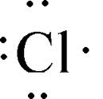
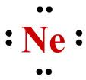
Lewis Dot Structure (Model)
Shows the number of valence electrons

Slide 17
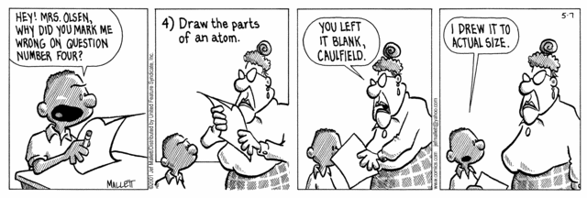
Practice
Pick three elements of your choice and draw the Lewis dot structure to represent them.

