Slide 1
Metric System

Slide 2
Objectives
Match appropriate metric tools and units
Identify the appropriate metric unit for a given measurement
Be able to convert between metric units

Slide 3
Metric System
Developed by the French in the late 1700’s.
Based on powers of ten, so it is very easy to use.
Used by almost every country in the world, with the notable exception of the USA.
Especially used by scientists.
Abbreviated SI, which is French for Systeme International.

Slide 4
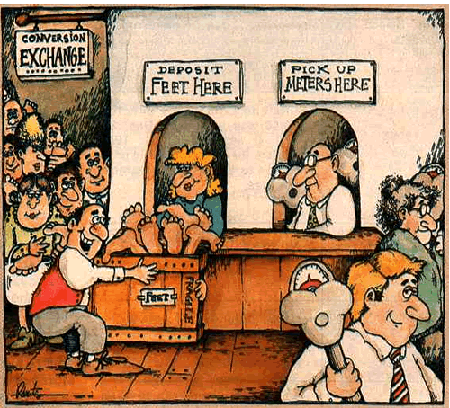
Metric Prefixes
Regardless of the unit, the entire metric system uses the same prefixes.
  Kilo = 1000
  Hecto = 100
  Deka = 10
  Meter/liter/gram = 1
  Deci = 1/10th
  Centi = 1/100th
  Milli = 1/1000th

Slide 5
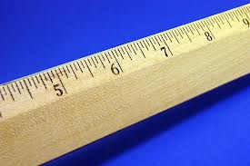
Length
Length is the distance between two points.
The SI base unit for length is the meter.
We use rulers or meter sticks to find the length of objects.

Slide 6
Mass
Mass is the amount of matter that makes up an object.
A golf ball and a ping pong ball are about the same size. Which one has more mass?
The SI unit for mass is the gram.
A paper clip has a mass of about one gram.

Slide 7
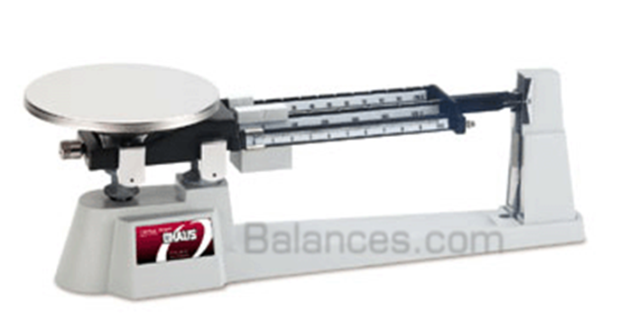
Measuring Mass
We will use a triple beam balance to measure mass.

Slide 8
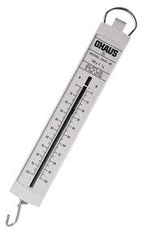
Weight
Weight measures the force of gravity on an object.
This is not the same as mass!
Your weight can change depending on the force of gravity. Mass stays constant.
The SI unit for weight is the Newton.
We can measure weight using a spring scale.

Slide 9
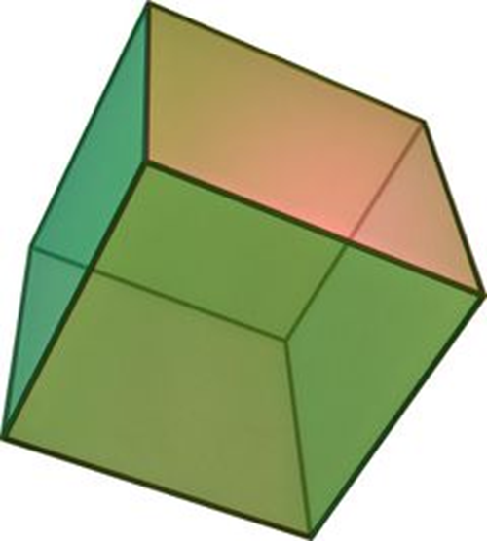
Volume
Volume is the amount of space contained in an object.
The SI unit is the liter (liquids) or cm³.
We can measure volume several ways:
  Calculation
  Graduated cylinder
  Water displacement

Slide 10
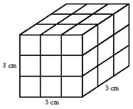
Calculating Volume
Volume = length x width x height
  V = L x W x H
Only works for cubic or rectangular objects
What is the volume of this cube?

Slide 11
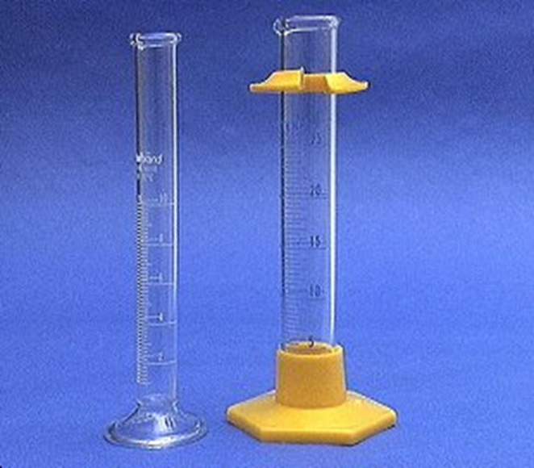
Liquid Volume
Measured with a graduated cylinder.
1 mL water = 1 cm³ water

Slide 12
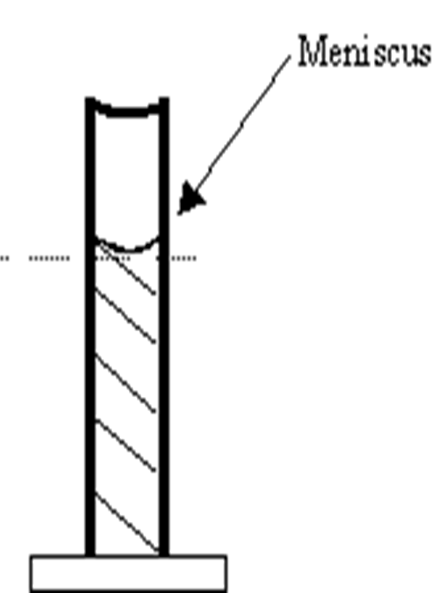
Reading Graduated Cylinders
Liquids form curved upper surfaces when poured into graduated cylinders.
To correctly read the volume, read the bottom of the curve called the meniscus.

Slide 13
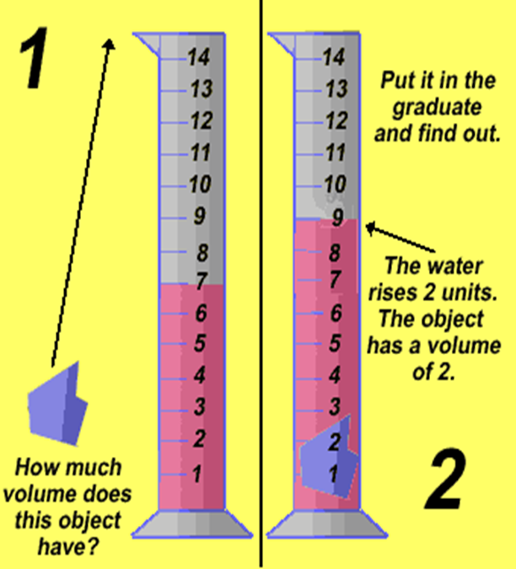
Water Displacement
We can use water displacement to find the volume of irregularly shaped solids.
We can put water in a graduated cylinder. If a rock causes the level to rise from 7 to 9 mL, the rock must have a volume of 2 mL.

Slide 14
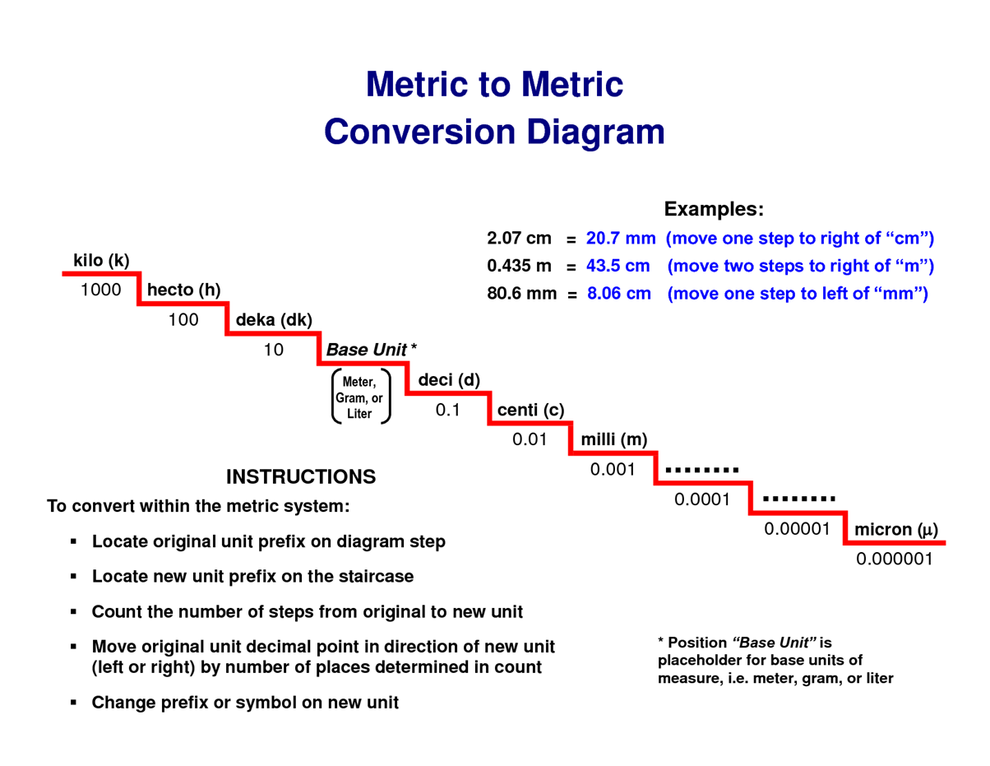

Slide 15
Conversion Practice
2 km = ____ mm
40000 cm = ___ m
0.003 L = ____ deciliters
567 hectograms = ____ dekagrams
31 cL = ___ kL

