Slide 1
Safety and Rules of the Lab
Notes:
http://www.rockwoodwaterandgas.com/sitebuildercontent/sitebuilderpictures/.pond/SAFETY.jpg.w300h388.jpg http://images.google.com/imgres?imgurl=http://68.90.81.6/ScienceTAKS/Integration/Science%2520TAKS%2520Objective%25201/safety4.jpg&imgrefurl=http://68.90.81.6/ScienceTAKS/Integration/Science%2520TAKS%2520Objective%25201/safetysymbols.htm&h=95&w=93&sz=3&hl=en&start=32&um=1&tbnid=AOIrcMWCY6-NPM:&tbnh=80&tbnw=78&prev=/images%3Fq%3DLab%2BSafety%2BSymbols%26start%3D20%26ndsp%3D20%26svnum%3D10%26um%3D1%26hl%3Den%26rls%3DGGLB,GGLB:1969-53,GGLB:en%26sa%3DN

Slide 2
Lab Safety Rules
Part of this PowerPoint has been taken from the power point of…. Tim Baker, Adam Kueltzo, and Todd Katz….former NCHS students
And from Lyndon B. Johnson High School Science Web Site
Notes:
http://images.google.com/imgres?imgurl=http://68.90.81.6/ScienceTAKS/Integration/Science%2520TAKS%2520Objective%25201/safety4.jpg&imgrefurl=http://68.90.81.6/ScienceTAKS/Integration/Science%2520TAKS%2520Objective%25201/safetysymbols.htm&h=95&w=93&sz=3&hl=en&start=32&um=1&tbnid=AOIrcMWCY6-NPM:&tbnh=80&tbnw=78&prev=/images%3Fq%3DLab%2BSafety%2BSymbols%26start%3D20%26ndsp%3D20%26svnum%3D10%26um%3D1%26hl%3Den%26rls%3DGGLB,GGLB:1969-53,GGLB:en%26sa%3DN

Slide 3
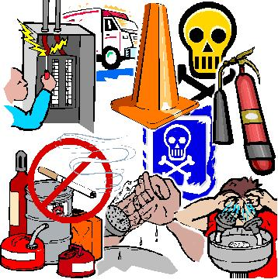
Safety Symbols
Know safety symbols
They appear in your laboratory activities
They will alert you to possible dangers
They will remind you to work carefully
Notes:
http://images.google.com/imgres?imgurl=http://www.utpb.edu/utpb_adm/BusinessAffairs/OfficeOfEHS/images/safety_main.jpg&imgrefurl=http://www.utpb.edu/utpb_adm/BusinessAffairs/OfficeOfEHS/index_frame.htm&h=360&w=358&sz=49&tbnid=M4hbjYJ8bTeETM:&tbnh=121&tbnw=120&prev=/images%3Fq%3Dsafety%2Bimages%26um%3D1&start=1&sa=X&oi=images&ct=image&cd=1

Slide 4
Use Your Head
Exercise Caution and Good Judgment
Follow all instructions given by the teacher
Notify the teacher immediately regarding any accident or unsafe areas

Slide 5
Use Your Head
Read lab instructions ahead of time
Always follow lab procedures exactly
Never do an unauthorized experiment

Slide 6
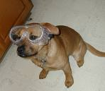
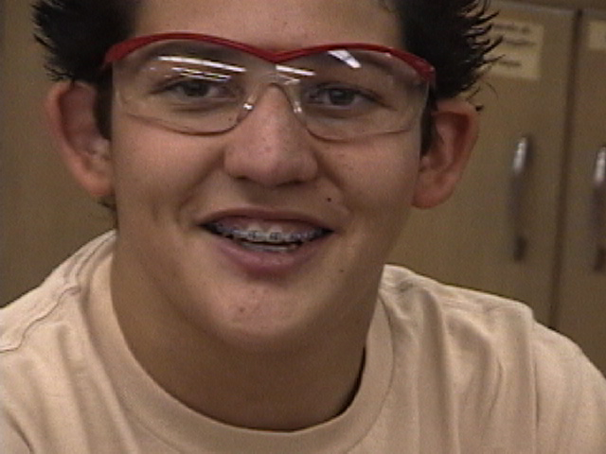
Protect Yourself Eye Safety
Wear safety goggles when working with chemicals, flames, or heating devices
or if possibility of flying debris
If you wear contact lenses let your teacher know
Notes:
http://images.google.com/imgres?imgurl=http://www.morrisonlabs.com/images/lab%2520safety/labkidsmistakes.jpg&imgrefurl=http://www.morrisonlabs.com/lab_safety.htm&h=319&w=600&sz=32&hl=en&start=101&um=1&tbnid=ijK8pYVbZiTVaM:&tbnh=72&tbnw=135&prev=/images%3Fq%3Dlab%2Bsafety%2Bimages%26start%3D100%26ndsp%3D20%26svnum%3D10%26um%3D1%26hl%3Den%26rls%3DGGLB,GGLB:1969-53,GGLB:en%26sa%3DN

Slide 7
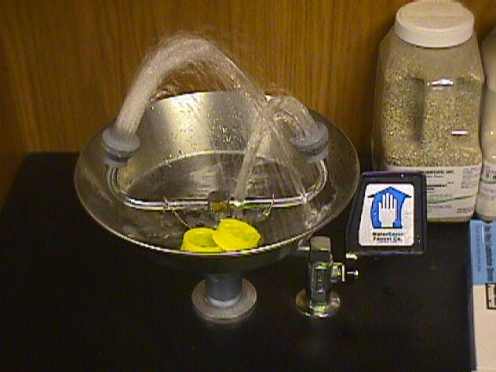
Protect Yourself Eye Safety
In case of emergency in which a chemical goes into one’s eye, use the eyewash station
Flush in water for 15 mins. and notify the teacher
Notes:
http://images.google.com/imgres?imgurl=http://www.morrisonlabs.com/images/lab%2520safety/labkidsmistakes.jpg&imgrefurl=http://www.morrisonlabs.com/lab_safety.htm&h=319&w=600&sz=32&hl=en&start=101&um=1&tbnid=ijK8pYVbZiTVaM:&tbnh=72&tbnw=135&prev=/images%3Fq%3Dlab%2Bsafety%2Bimages%26start%3D100%26ndsp%3D20%26svnum%3D10%26um%3D1%26hl%3Den%26rls%3DGGLB,GGLB:1969-53,GGLB:en%26sa%3DN

Slide 8
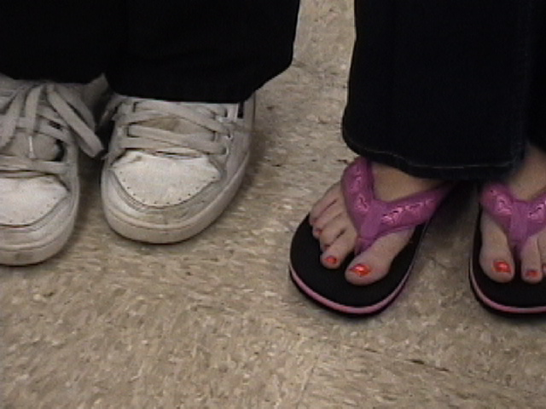
Protect Yourself Proper Attire
Keep all long hair tied back
Do not wear loose clothing that could catch on fire
Foot wear that completely covers the foot is required
Notes:
http://images.google.com/imgres?imgurl=http://sme.clc.uc.edu/labsafety/Amy%2520%26%2520Shower.JPG&imgrefurl=http://sme.clc.uc.edu/labsafety/index.htm&h=400&w=400&sz=166&hl=en&start=41&um=1&tbnid=kaMEXKY4mzKodM:&tbnh=124&tbnw=124&prev=/images%3Fq%3Dlab%2Bsafety%2Bimages%26start%3D40%26ndsp%3D20%26svnum%3D10%26um%3D1%26hl%3Den%26rls%3DGGLB,GGLB:1969-53,GGLB:en%26sa%3DN http://images.google.com/imgres?imgurl=http://www.morrisonlabs.com/images/lab%2520safety/labkidsmistakes.jpg&imgrefurl=http://www.morrisonlabs.com/lab_safety.htm&h=319&w=600&sz=32&hl=en&start=101&um=1&tbnid=ijK8pYVbZiTVaM:&tbnh=72&tbnw=135&prev=/images%3Fq%3Dlab%2Bsafety%2Bimages%26start%3D100%26ndsp%3D20%26svnum%3D10%26um%3D1%26hl%3Den%26rls%3DGGLB,GGLB:1969-53,GGLB:en%26sa%3DN

Slide 9
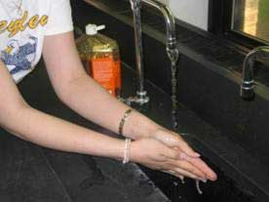
Protect Yourself Hand Safety
If a chemical spills on your skin, notify the teacher and rinse with water for 15 minutes
Wash hands after every lab
Handle glassware, sharp tools and heated containers carefully
Notes:
http://images.google.com/imgres?imgurl=http://68.90.81.6/ScienceTAKS/Integration/Science%2520TAKS%2520Objective%25201/safety4.jpg&imgrefurl=http://68.90.81.6/ScienceTAKS/Integration/Science%2520TAKS%2520Objective%25201/safetysymbols.htm&h=95&w=93&sz=3&hl=en&start=32&um=1&tbnid=AOIrcMWCY6-NPM:&tbnh=80&tbnw=78&prev=/images%3Fq%3DLab%2BSafety%2BSymbols%26start%3D20%26ndsp%3D20%26svnum%3D10%26um%3D1%26hl%3Den%26rls%3DGGLB,GGLB:1969-53,GGLB:en%26sa%3DN

Slide 10
Protect Yourself Hand Safety
Notes:
http://images.google.com/imgres?imgurl=http://www.cartoonstock.com/newscartoons/cartoonists/mfl/lowres/mfln160l.jpg&imgrefurl=http://www.cartoonstock.com/directory/s/science_lab.asp&h=400&w=370&sz=27&hl=en&start=2&um=1&tbnid=XdURqFQR7vf2GM:&tbnh=124&tbnw=115&prev=/images%3Fq%3Dscience%2Blab%2Bsafety%2Bicons%26svnum%3D10%26um%3D1%26hl%3Den%26rls%3DGGLB,GGLB:1969-53,GGLB:en%26sa%3DG

Slide 11
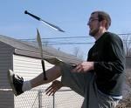
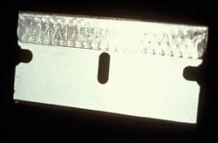
Sharp Objects
 | • When using knifes or other sharp objects always walk with the points
Always cut away from fingers and body
Always carry sharp objects with points and tips facing down and away
Never try to catch falling sharp instruments
Grasp sharp instruments only by the handles
Notes:
http://images.google.com/imgres?imgurl=http://68.90.81.6/ScienceTAKS/Integration/Science%2520TAKS%2520Objective%25201/safety4.jpg&imgrefurl=http://68.90.81.6/ScienceTAKS/Integration/Science%2520TAKS%2520Objective%25201/safetysymbols.htm&h=95&w=93&sz=3&hl=en&start=32&um=1&tbnid=AOIrcMWCY6-NPM:&tbnh=80&tbnw=78&prev=/images%3Fq%3DLab%2BSafety%2BSymbols%26start%3D20%26ndsp%3D20%26svnum%3D10%26um%3D1%26hl%3Den%26rls%3DGGLB,GGLB:1969-53,GGLB:en%26sa%3DN

Slide 12
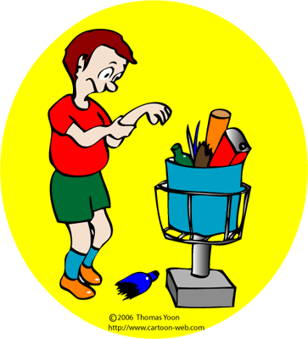
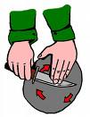
Sharp Objects
 | • When using knifes or other sharp objects always walk with the points
 | • When using knifes or other sharp objects always walk with the points
Notify teacher if you get cut
Broken glass and sharp objects do not go in trash cans
Teacher will clean up broken glass
Notes:
http://images.google.com/imgres?imgurl=http://68.90.81.6/ScienceTAKS/Integration/Science%2520TAKS%2520Objective%25201/safety4.jpg&imgrefurl=http://68.90.81.6/ScienceTAKS/Integration/Science%2520TAKS%2520Objective%25201/safetysymbols.htm&h=95&w=93&sz=3&hl=en&start=32&um=1&tbnid=AOIrcMWCY6-NPM:&tbnh=80&tbnw=78&prev=/images%3Fq%3DLab%2BSafety%2BSymbols%26start%3D20%26ndsp%3D20%26svnum%3D10%26um%3D1%26hl%3Den%26rls%3DGGLB,GGLB:1969-53,GGLB:en%26sa%3DN

Slide 13
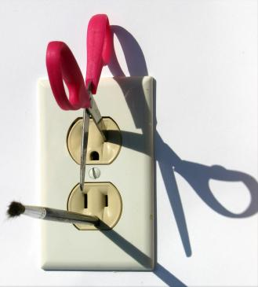
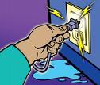
Electrical Safety
Only electrical plugs are to be placed into an electrical outlet
Unplug electrical equipment after use
Keep all electrical cords, wires, and appliances away from water
Notes:
http://images.google.com/imgres?imgurl=http://68.90.81.6/ScienceTAKS/Integration/Science%2520TAKS%2520Objective%25201/safety4.jpg&imgrefurl=http://68.90.81.6/ScienceTAKS/Integration/Science%2520TAKS%2520Objective%25201/safetysymbols.htm&h=95&w=93&sz=3&hl=en&start=32&um=1&tbnid=AOIrcMWCY6-NPM:&tbnh=80&tbnw=78&prev=/images%3Fq%3DLab%2BSafety%2BSymbols%26start%3D20%26ndsp%3D20%26svnum%3D10%26um%3D1%26hl%3Den%26rls%3DGGLB,GGLB:1969-53,GGLB:en%26sa%3DN

Slide 14
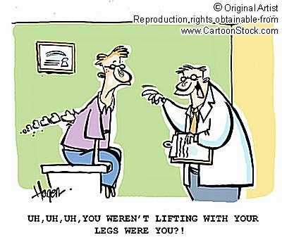
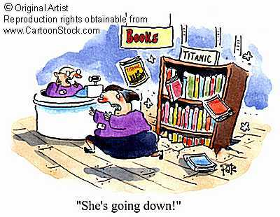
Physical Safety
Handle all equipment carefully
Do not place a cord where someone can trip over it
Push all stools in out of the way
Keep books picked up out of walking isles
Notes:
http://images.google.com/imgres?imgurl=http://68.90.81.6/ScienceTAKS/Integration/Science%2520TAKS%2520Objective%25201/safety4.jpg&imgrefurl=http://68.90.81.6/ScienceTAKS/Integration/Science%2520TAKS%2520Objective%25201/safetysymbols.htm&h=95&w=93&sz=3&hl=en&start=32&um=1&tbnid=AOIrcMWCY6-NPM:&tbnh=80&tbnw=78&prev=/images%3Fq%3DLab%2BSafety%2BSymbols%26start%3D20%26ndsp%3D20%26svnum%3D10%26um%3D1%26hl%3Den%26rls%3DGGLB,GGLB:1969-53,GGLB:en%26sa%3DN http://www.cartoonstock.com/newscartoons/cartoonists/rha/lowres/rhan190l.jpg

Slide 15
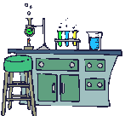
Heating Safety
Tie back hair and loose clothes when working with open flames
Never look into a container as you are heating it
Never point the end of a test tube being heated at yourself or others
Never heat in a closed container

Slide 16
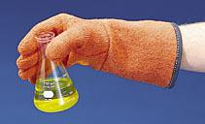
Heating Safety
Never leave a heat source unattended
Heated metal and glass looks cool, use tongs or gloves before handling
Do not place hot glassware directly on lab desk or in cold water

Slide 17
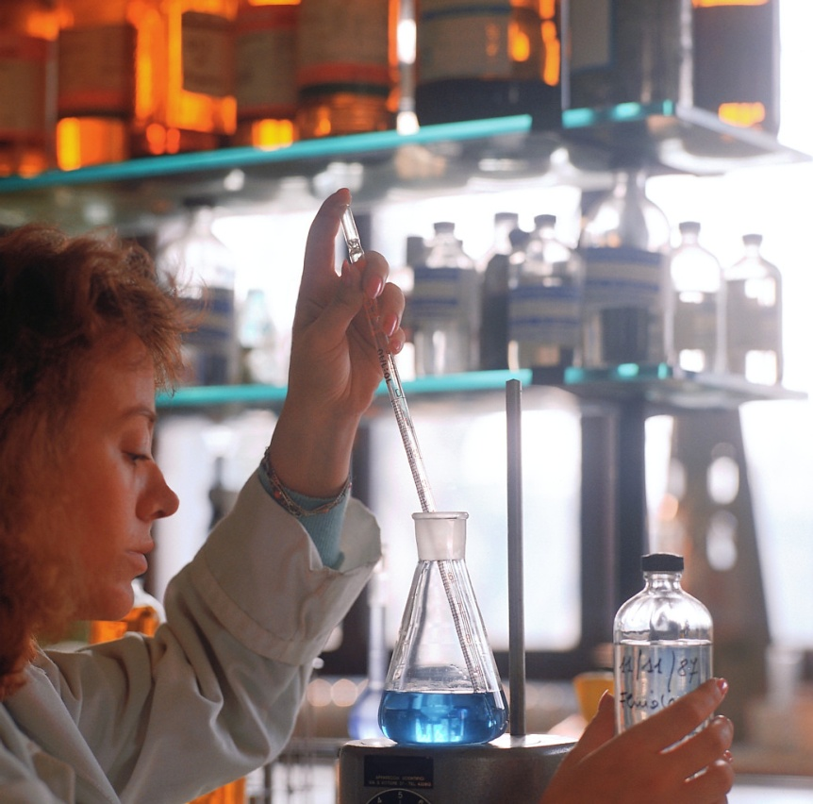
Chemical Safety
Read all labels twice before removing a chemical from the container
Only use the type and amount of chemical instructed to use
Never touch, taste, or smell a chemical unless instructed by the teacher
Never mix chemicals unless instructed to do so
Notes:
http://images.google.com/imgres?imgurl=http://68.90.81.6/ScienceTAKS/Integration/Science%2520TAKS%2520Objective%25201/safety4.jpg&imgrefurl=http://68.90.81.6/ScienceTAKS/Integration/Science%2520TAKS%2520Objective%25201/safetysymbols.htm&h=95&w=93&sz=3&hl=en&start=32&um=1&tbnid=AOIrcMWCY6-NPM:&tbnh=80&tbnw=78&prev=/images%3Fq%3DLab%2BSafety%2BSymbols%26start%3D20%26ndsp%3D20%26svnum%3D10%26um%3D1%26hl%3Den%26rls%3DGGLB,GGLB:1969-53,GGLB:en%26sa%3DN http://www.physics.utah.edu/facilities/safety/18chood.gif

Slide 18
Chemical Safety

Slide 19
Chemical Safety
Transfer chemicals carefully!
Keep lids on chemical containers when not in use
When diluting an acid, pour the acid into water
Consider all chemicals dangerous
Notes:
http://images.google.com/imgres?imgurl=http://68.90.81.6/ScienceTAKS/Integration/Science%2520TAKS%2520Objective%25201/safety4.jpg&imgrefurl=http://68.90.81.6/ScienceTAKS/Integration/Science%2520TAKS%2520Objective%25201/safetysymbols.htm&h=95&w=93&sz=3&hl=en&start=32&um=1&tbnid=AOIrcMWCY6-NPM:&tbnh=80&tbnw=78&prev=/images%3Fq%3DLab%2BSafety%2BSymbols%26start%3D20%26ndsp%3D20%26svnum%3D10%26um%3D1%26hl%3Den%26rls%3DGGLB,GGLB:1969-53,GGLB:en%26sa%3DN http://www.physics.utah.edu/facilities/safety/18chood.gif

Slide 20
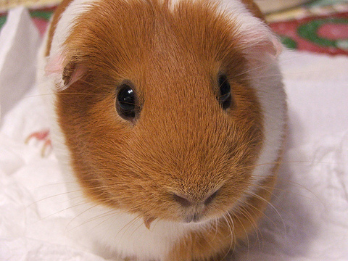
Animal Safety
Only handle living organisms with teacher permission
Always treat living organisms humanely
Wash your hands after handling animals
Notes:
http://images.google.com/imgres?imgurl=http://68.90.81.6/ScienceTAKS/Integration/Science%2520TAKS%2520Objective%25201/safety4.jpg&imgrefurl=http://68.90.81.6/ScienceTAKS/Integration/Science%2520TAKS%2520Objective%25201/safetysymbols.htm&h=95&w=93&sz=3&hl=en&start=32&um=1&tbnid=AOIrcMWCY6-NPM:&tbnh=80&tbnw=78&prev=/images%3Fq%3DLab%2BSafety%2BSymbols%26start%3D20%26ndsp%3D20%26svnum%3D10%26um%3D1%26hl%3Den%26rls%3DGGLB,GGLB:1969-53,GGLB:en%26sa%3DN http://www.inkycircus.com/jargon/images/guineapig_5.jpg

Slide 21
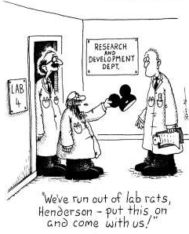
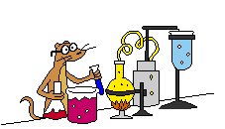
Treatment of Specimen
Respect the life of all laboratory specimen
They gave their life for your education
Notes:
http://staffwww.fullcoll.edu/jchadwick/science2.gif http://images.google.com/imgres?imgurl=http://68.90.81.6/ScienceTAKS/Integration/Science%2520TAKS%2520Objective%25201/safety4.jpg&imgrefurl=http://68.90.81.6/ScienceTAKS/Integration/Science%2520TAKS%2520Objective%25201/safetysymbols.htm&h=95&w=93&sz=3&hl=en&start=32&um=1&tbnid=AOIrcMWCY6-NPM:&tbnh=80&tbnw=78&prev=/images%3Fq%3DLab%2BSafety%2BSymbols%26start%3D20%26ndsp%3D20%26svnum%3D10%26um%3D1%26hl%3Den%26rls%3DGGLB,GGLB:1969-53,GGLB:en%26sa%3DN

Slide 22
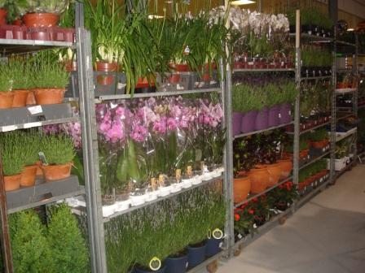
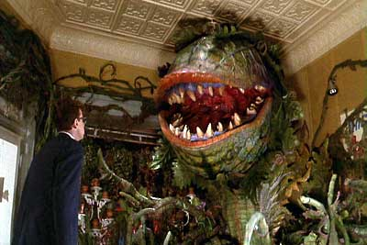
Plant Safety
Do not eat any plants in lab
Wash your hands after handling plants
Tell your teacher of any plant allergies
Like any organism, plants should be considered possibly harmful
Notes:
http://images.google.com/imgres?imgurl=http://68.90.81.6/ScienceTAKS/Integration/Science%2520TAKS%2520Objective%25201/safety4.jpg&imgrefurl=http://68.90.81.6/ScienceTAKS/Integration/Science%2520TAKS%2520Objective%25201/safetysymbols.htm&h=95&w=93&sz=3&hl=en&start=32&um=1&tbnid=AOIrcMWCY6-NPM:&tbnh=80&tbnw=78&prev=/images%3Fq%3DLab%2BSafety%2BSymbols%26start%3D20%26ndsp%3D20%26svnum%3D10%26um%3D1%26hl%3Den%26rls%3DGGLB,GGLB:1969-53,GGLB:en%26sa%3DN

Slide 23
You Should Never…
Enter store room unless given permission
Take any chemicals from lab or store room
Touch any equipment, chemicals, or other materials until instructed to do so

Slide 24
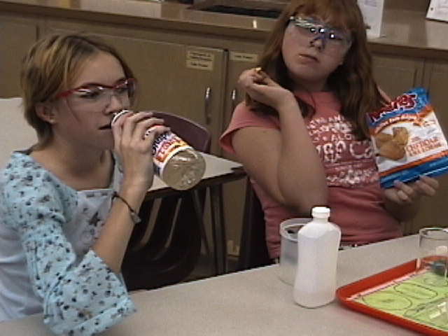
You Should Never…
Eat or drink in the lab
Use lab glass-ware to eat or drink out of
Notes:
http://images.google.com/imgres?imgurl=http://68.90.81.6/ScienceTAKS/Integration/Science%2520TAKS%2520Objective%25201/safety4.jpg&imgrefurl=http://68.90.81.6/ScienceTAKS/Integration/Science%2520TAKS%2520Objective%25201/safetysymbols.htm&h=95&w=93&sz=3&hl=en&start=32&um=1&tbnid=AOIrcMWCY6-NPM:&tbnh=80&tbnw=78&prev=/images%3Fq%3DLab%2BSafety%2BSymbols%26start%3D20%26ndsp%3D20%26svnum%3D10%26um%3D1%26hl%3Den%26rls%3DGGLB,GGLB:1969-53,GGLB:en%26sa%3DN

Slide 25
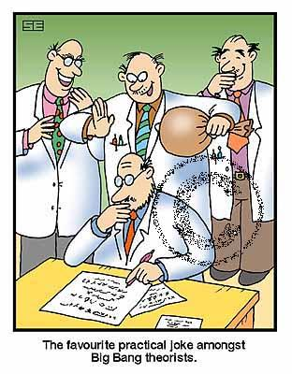
You Should Never…
Engage in….
practical jokes
horse play
rough house
Notes:
http://www.cartoonstock.com/lowres/sea0209l.jpg

Slide 26
In case of an emergency…
Know the locations of:
fire extinguisher
fire blanket
body shower
eyewash station
first aid kit
If you spill a harmful chemical on yourself or in your eyes, start rinsing immediately and send your partner to get teacher’s help

Slide 27
Remember to…
Stay at your work station
Maintain a clean work area
Read and follow all directions
Report any spills, accidents, or injury to the teacher immediately
Clean and put away all equipment at the end of the lab period
Dispose of waste products according to instruction

Slide 28
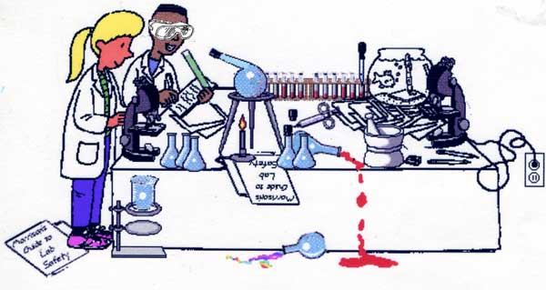
So Do It Right!
Notes:
http://www.blinn.edu/brazos/natscience/lab/man.gif http://images.google.com/imgres?imgurl=http://www.morrisonlabs.com/images/lab%2520safety/labkidsmistakes.jpg&imgrefurl=http://www.morrisonlabs.com/lab_safety.htm&h=319&w=600&sz=32&hl=en&start=101&um=1&tbnid=ijK8pYVbZiTVaM:&tbnh=72&tbnw=135&prev=/images%3Fq%3Dlab%2Bsafety%2Bimages%26start%3D100%26ndsp%3D20%26svnum%3D10%26um%3D1%26hl%3Den%26rls%3DGGLB,GGLB:1969-53,GGLB:en%26sa%3DN

