Slide 1
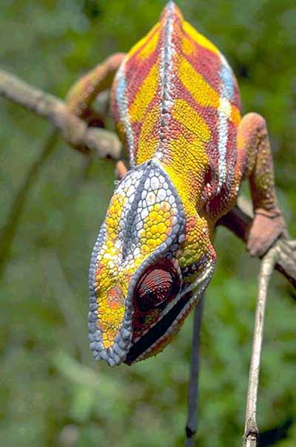
Bellwork
Make 5 observations about the lizard in the picture. Identify the observations as qualitative (descriptive) or quantitative (numerical) data.
In your own words, explain what a hypothesis is.
True or False: Science is a set of truths that never change.

Slide 2
What is it?
Photo courtesy David Parks
Chamaeleo pardalis, a chameleon species found in the forests of Madagascar. Chameleons can produce a wide range of colors and patterns on their skin, but they do this primarily to express mood, not to blend in with different environments.

Slide 3
Vocabulary
  Observation - use of one or more of the senses—sight, hearing, touch, smell, and sometimes taste—to gather information
    Can be qualitative or quantitative
  Data -evidence; information gathered from observations
  Inference - logical interpretation based on prior knowledge and experience

Slide 4
Vocabulary: Hypothesis
A proposed scientific answer to a question.
Should be proposed in a way that it can be tested.
How can hypotheses be tested?
Using controlled experiments
Collecting more data

Slide 5
What is Science?
Textbook: An organized way of using evidence to learn about the natural world.
Write this definition in your own words…

Slide 6
Forming a hypothesis activity:
1. Get into your groups. Do not open the bag.
2. Allow each group member to feel of the items through the bag for one minute and record data about the objects.
3. Record your data about the objects in the bag by describing them in great detail and drawing them.
4. Discuss each person’s ideas as a team and come up with a hypothesis about what is in the bag.

Slide 7
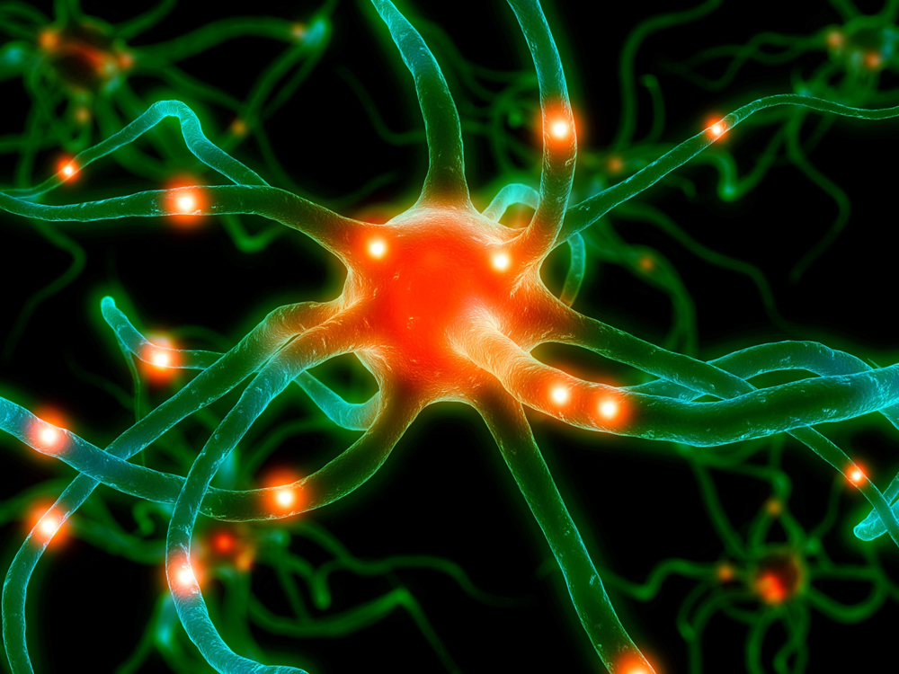
What is spontaneous generation?
The idea that life could arise from nonliving things.
This is also called abiogenesis!
Biogenesis: the conclusion that complex living things come only from other living things

Slide 8
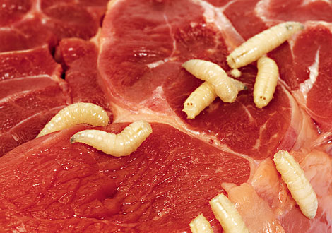
Francesco Redi’s experiment
Observation: Maggots often appear on discarded meat
Question:
Where do maggots
come from?
Hypothesis: Maggots come from flies landing on the meat
Video

Slide 9
Theory
In science:
  A theory is a well-tested hypothesis
No theory is ever considered absolute truth.

Slide 10
Setting up a controlled experiment:
Factors about the experiment that can change are called variables.
Example: When experimenting with plants, what are some variables that could change during the experiment?
It is best to change only one variable at a time during a controlled experiment.

Slide 11
Types of variables
Controlled variable (aka Constant Factor)
  the variable that is kept the same in an experiment
Independent variable
  the variable that is deliberately changed in an experiment
Dependent variable (responding variable)
  the variable that is observed (measured) and that changes in response to the manipulated variable

Slide 12
Groups
Experimental Group
  An experimental group is the group in an experiment that receives the variable being tested. One variable (the independent variable) is tested at a time.
Control Group
  A control group is a group separated from the rest of the experiment where the independent variable being tested cannot influence the results.

Slide 13
Checkup!
1.) What is inference?
2.) What is one characteristic of a good hypothesis?
3.) How do you test a hypothesis?
4.) What did Francesco Redi’s experiment disprove?

Slide 14
Checkup (answers)
1.) What is inference?
An inference is a logical assumption based on some knowledge/testing of the subject.
2.) What is one characteristic of a good hypothesis?
A good hypothesis is testable; it is sometimes formed with an if-then statement.

Slide 15
Checkup (answers)
3.) How do you test a hypothesis?
A hypothesis can be tested by controlled experiment or collecting more data.
4.) What did Francesco Redi’s experiment disprove?
Francesco Redi’s experiment disproved spontaneous generation, it proved that maggots come from flies laying their eggs on food.

Slide 16
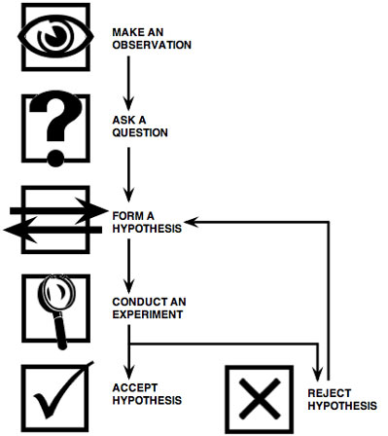
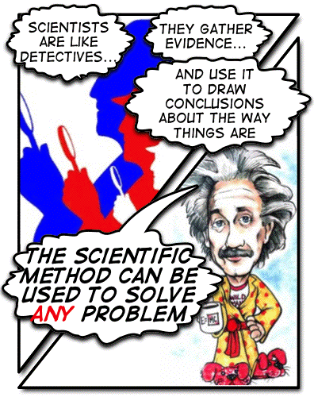
The Scientific Method

Slide 17
Problem
  Observation
  Question
Research
Hypothesis
Experiment
  Test and retest
Data
  Observe, Record, and Analyze Results
Conclusion
  Publish (Report)
  Repeat Investigations (Experiments) by others
The Scientific Method

Slide 18
When Experiments are Not Possible
When natural occurrences must not be disturbed
  Learn how animals interact in the wild
Ethical considerations
  Determine the effect of a chemical on humans

Slide 19
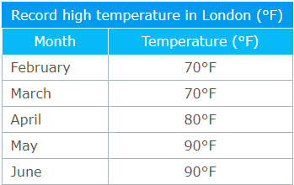
Graphs
Create a line graph with the following data:

Slide 20
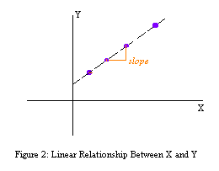
Remember…
DRY MIX
Dependent (Responding) variables are graphed on the Y-axis (this variable depends on the other variable)
Manipulated (Independent) variables are graphed on the X-axis

Slide 21
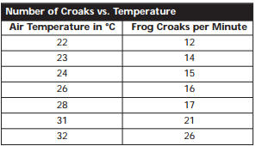
Again….
A scientist studying frogs recorded the number of croaks at different temperatures….
Create a line graph with the following data:

Slide 22
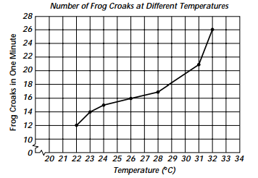
Answer:
Independent variable?
Dependent variable?

Slide 23
Checkup!
  * Write questions and answers!
1. Factors that can be changed in an experiment are called _____________.
2. __________ is an organized way of using evidence to learn about the natural world.
3. In your own words, what is the difference between quantitative and qualitative observations?

Slide 24
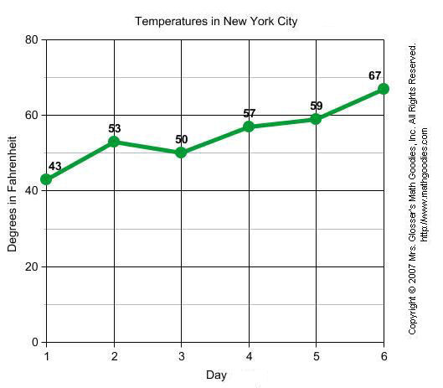
Graphs:
Create a table of data based on the graph…

Slide 25
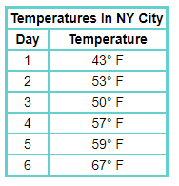
Answer:

Slide 26
Studying Life
Biology
  bios means “life”
  -logy means “study of”
Biology is the study of living things….but how do we determine if something is living?

Slide 27
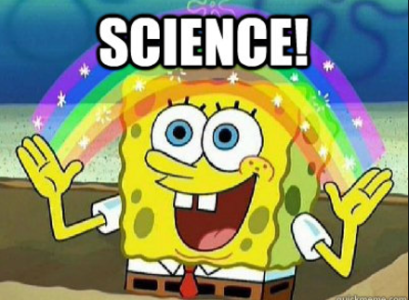
Controlled experiments with spongebob!

Slide 28
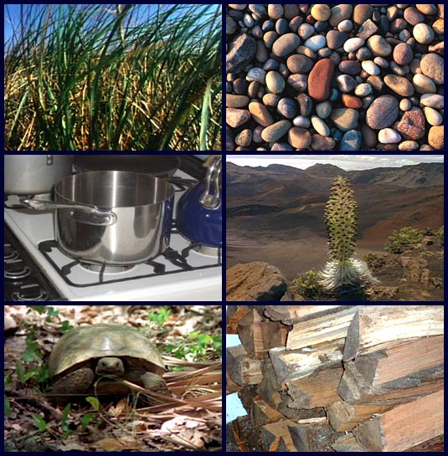

Slide 29
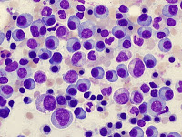
Characteristics of Living Things
Living things:
  are made up of cells
  reproduce
  Have DNA (genetic code)
  grow and develop
  obtain and use materials and energy
  respond to their environment
  maintain homeostasis (a stable internal environment)
  as a group, living things change over time

Slide 30
Classwork
1. What is homeostasis?
2. Give an example of homeostasis in the human body.
3. _____________ includes all the chemical reactions that take place in an organism.
4. What is the difference between how light microscopes and electron microscopes produce an image?

Slide 31
Study Tips
Review the Powerpoint
Reread your notes
Quiz yourself on the vocabulary words
Study for at least an hour the night before the test / quiz

Slide 32
#moldybread
Describe how you would perform an experiment that will determine the effect of moisture on bread mold.
Be as detailed as possible when describing the procedure. You may also use drawings.
Identify your controlled variables, manipulated variables, and responding variables.

Slide 33
Peer Review
Have another student review your bread mold experiment and review theirs as well.
Make sure both are clearly explained on paper.
Have them sign the bottom of your paper to show that they have reviewed the idea.

