Slide 1
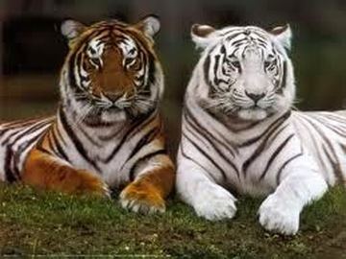
Big Question: How do living things Change over time?

Slide 2
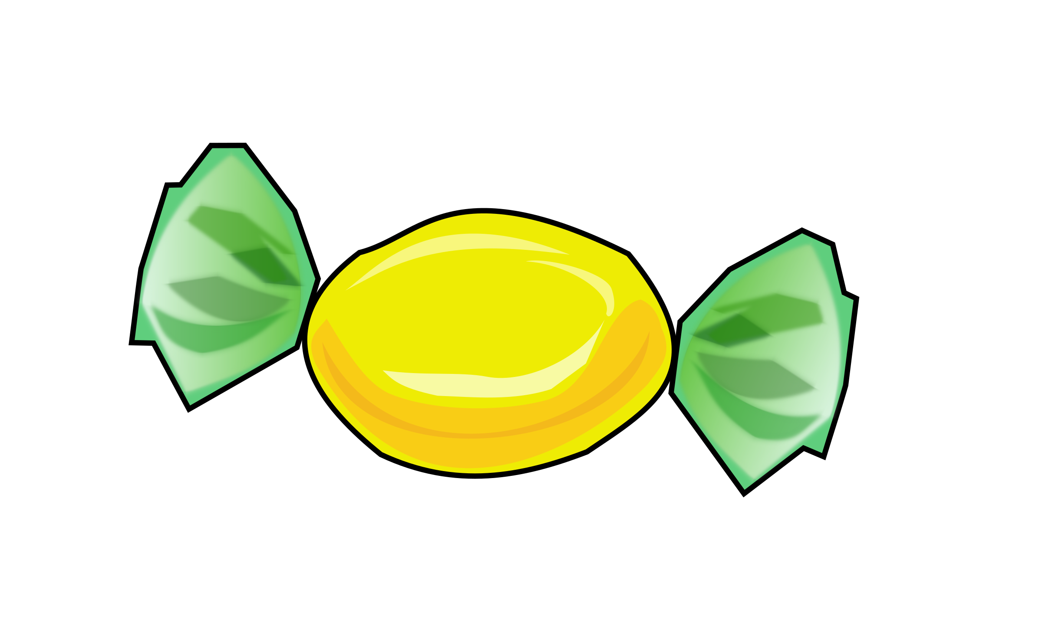
Vocab Candy
Theory – A well tested concept that explains a wide range of observations
Example: The cell theory says that all organisms are made of cells.
A theory is NOT a guess!!!!

Slide 3
Vocab Candy
Adaptation – A trait that helps an individual survive and reproduce.
Example: Fur is an adaptation to cold.
An adaptation is NOT a change in an individual’s behavior!

Slide 4
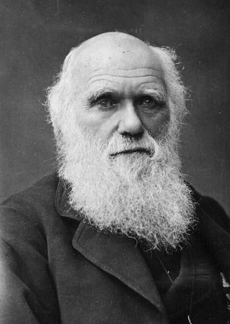
Who is Charles Darwin?
Darwin was a naturalist who studied organisms and came up with a big theory!
Darwin’s Theory of Evolution says that species change over many generations and become better adapted to new conditions.

Slide 5
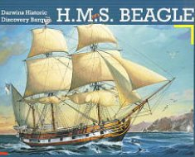
How did Charles Darwin come up with his theory?
In 1831, Darwin boarded the British ship called the HMS Beagle for a five year trip around the world! Darwin was amazed at the diversity of living things he saw during the voyage! He wondered, “How many different types of organisms could there be??!”

Slide 6
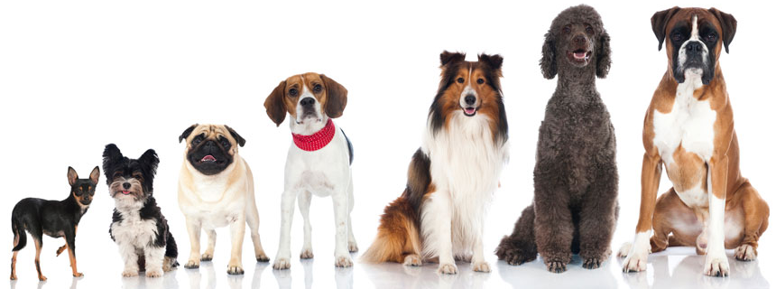
Vocab Candy
Species – A group of similar organisms that can mate with each other and produce fertile offspring.
Example: All domestic dogs are the same species even though they can look very different.

Slide 7
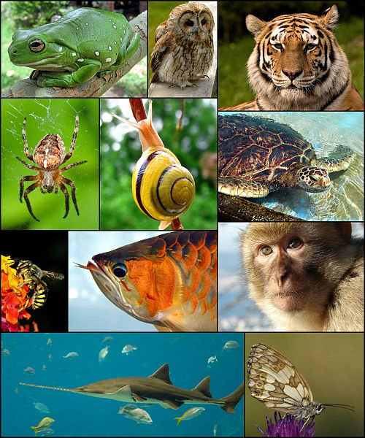
How many different species are there?
Today scientists know that organisms are even more diverse than Darwin thought. In fact, scientists have identified more than 1.6 million species of organisms on Earth and they are still discovering new species!

Slide 8
Vocab Candy
Fossil – the preserved remains or traces of an organism that lived in the past.
Example: Darwin saw fossils of animals that had died long ago. He saw fossils that resembled the bones of living sloths, but were much larger.

Slide 9
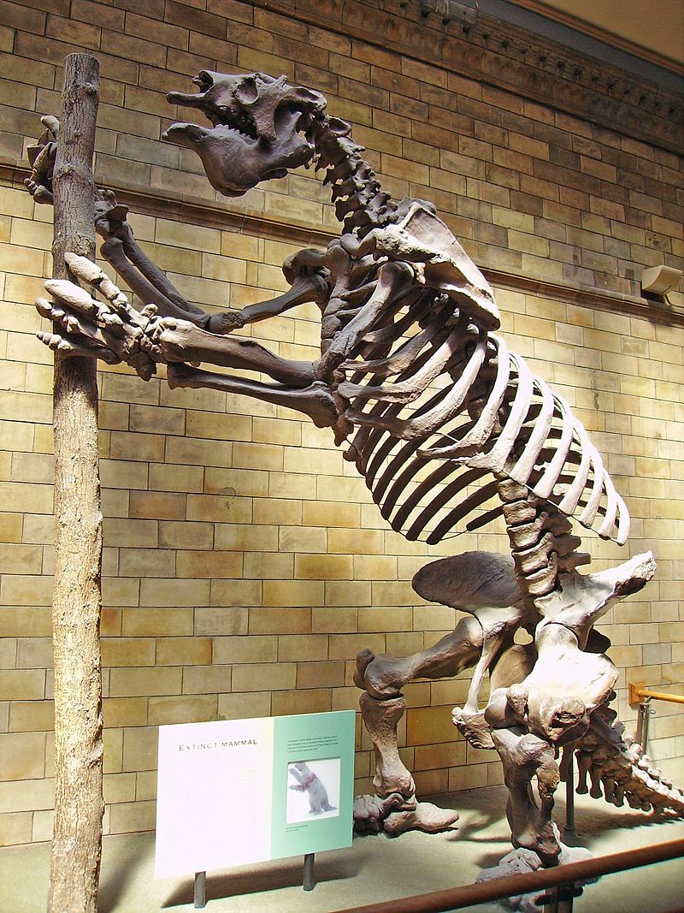
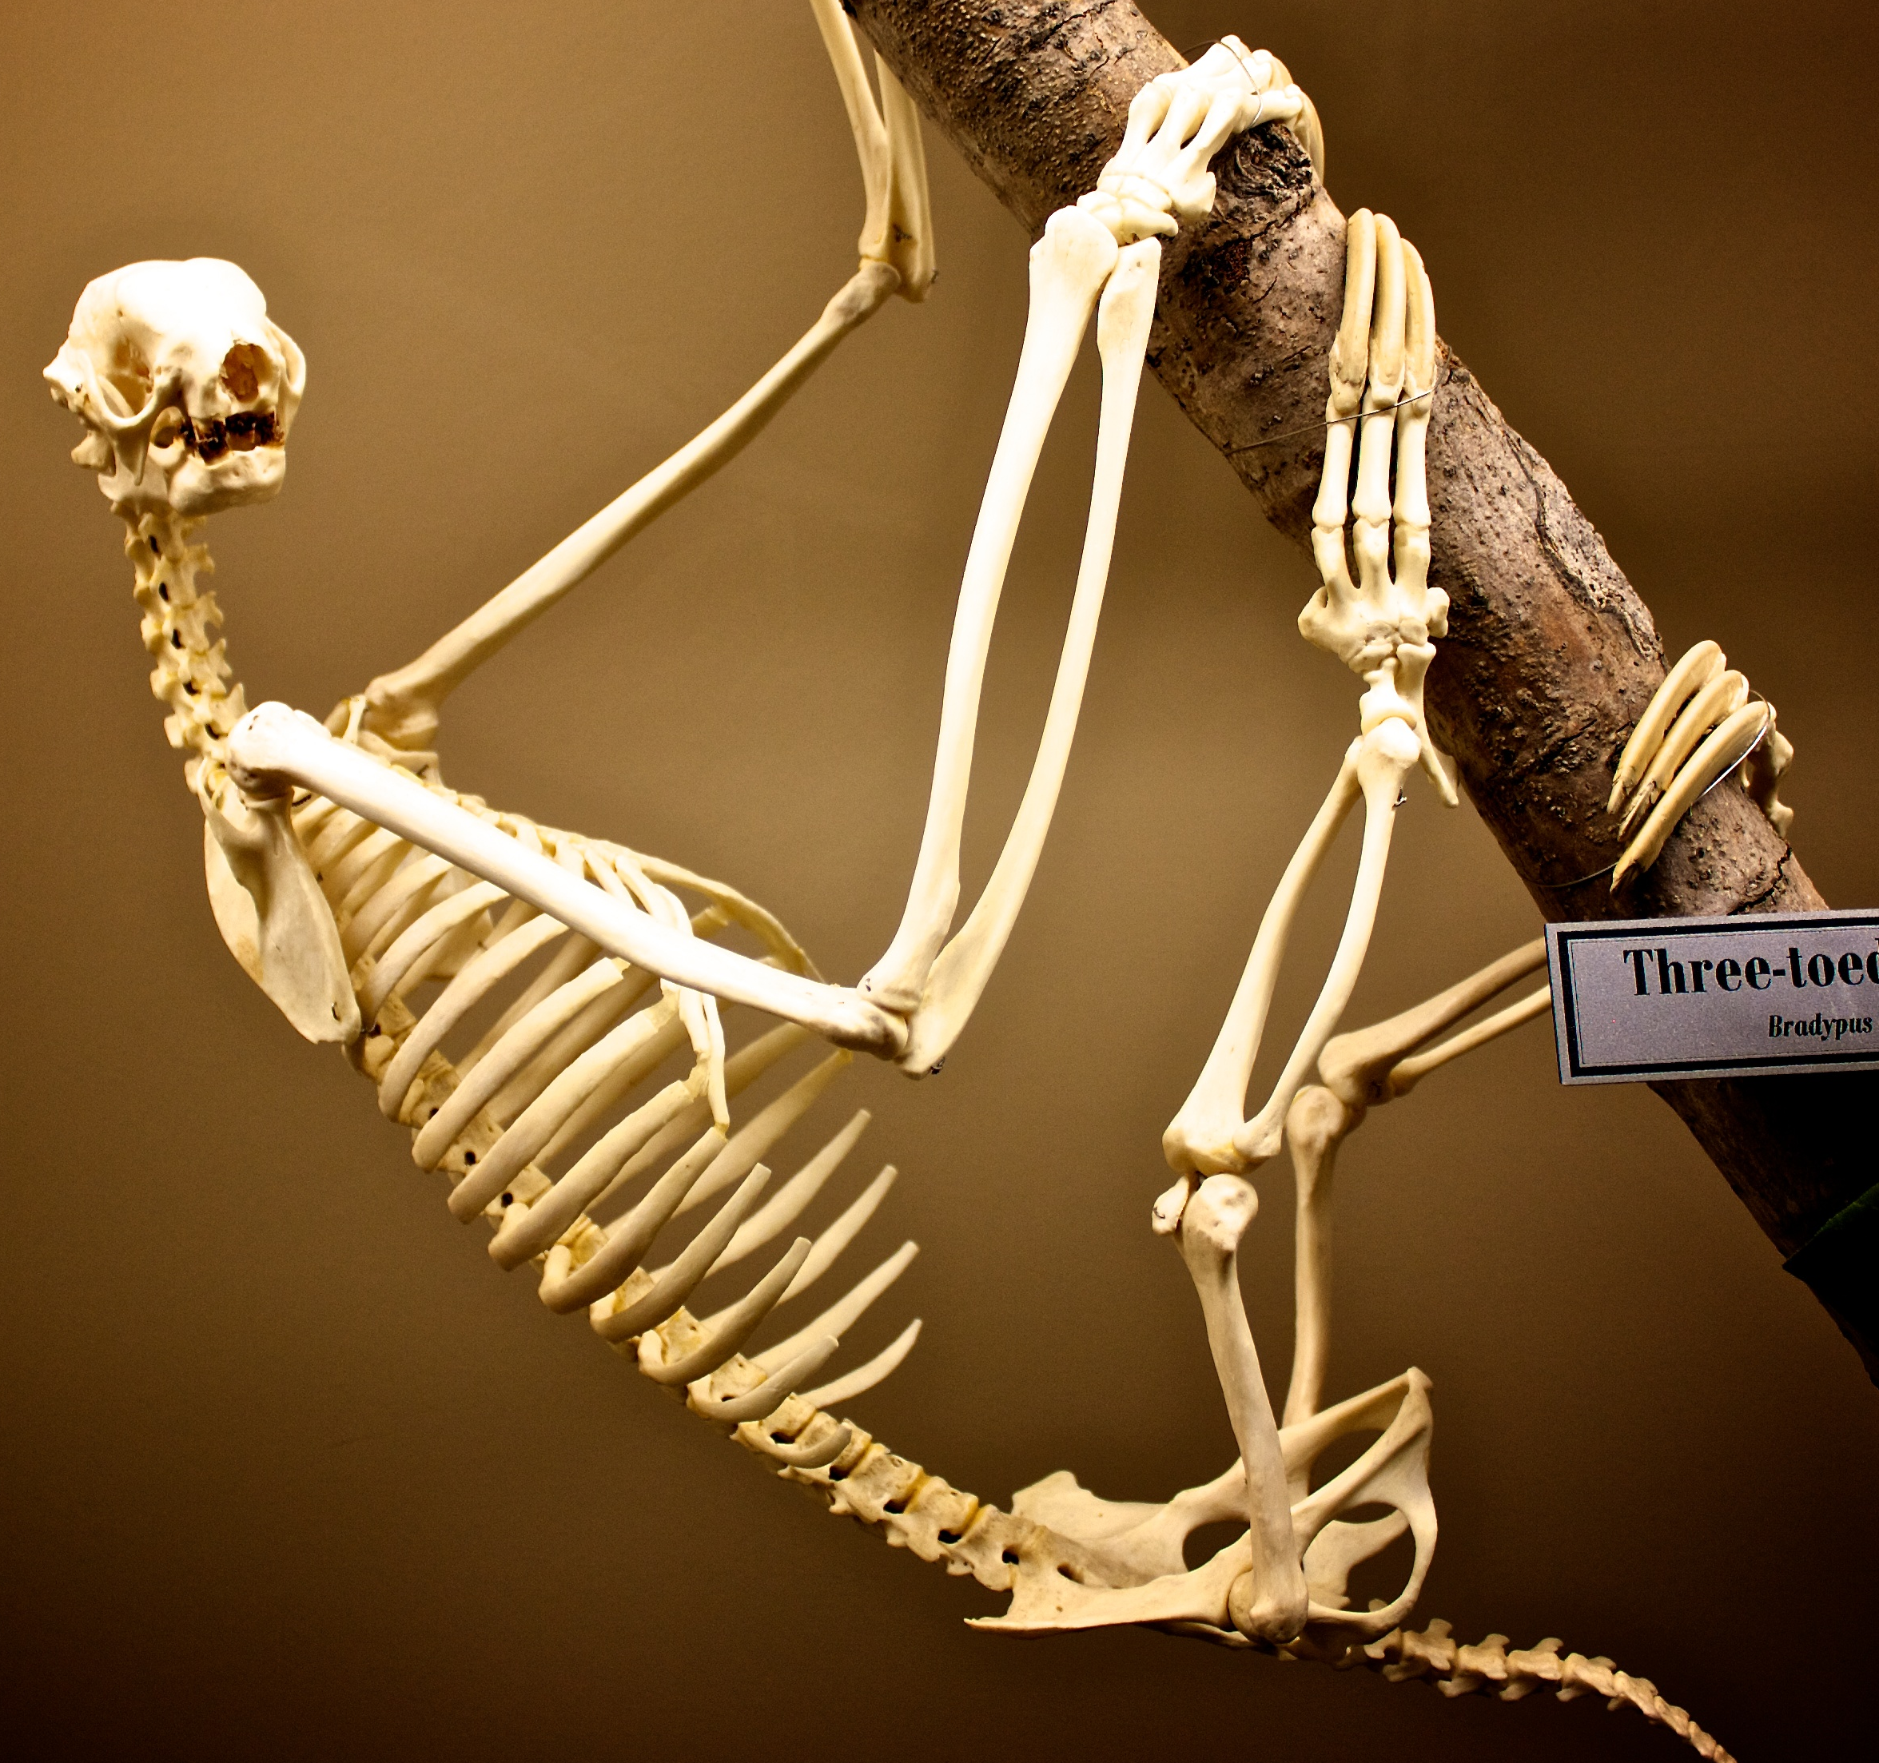
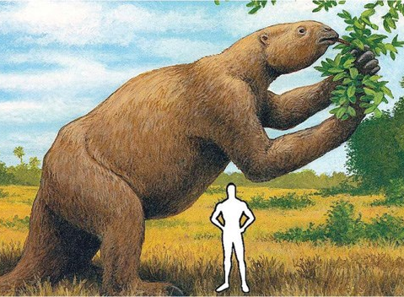
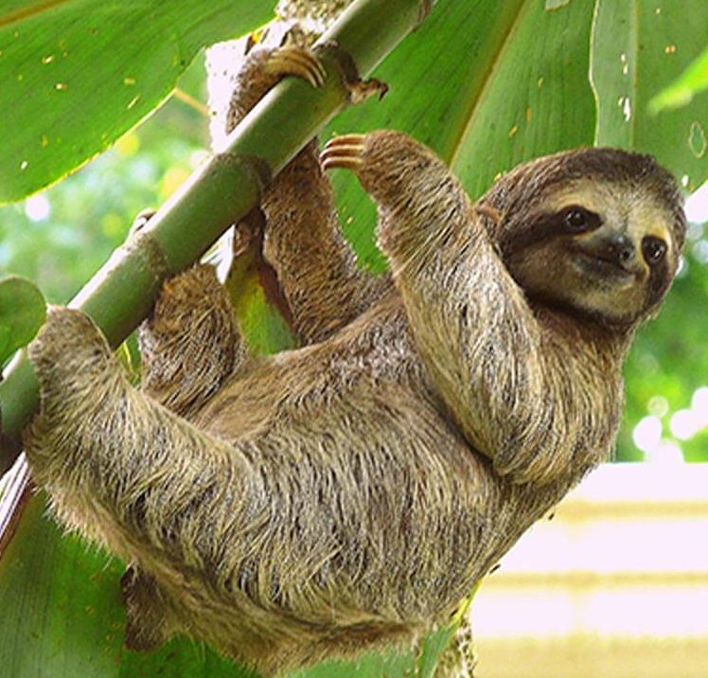
Darwin thought that the fossil bones of the giant ground sloths resembled the bones of modern day sloths.
Identify two similarities that you notice between the two sloths.

