Slide 1
Graphing and Analyzing Data

Slide 2
3 Main Types of Graphs
Bar graph
Used for comparison
Line graph
Shows change over time
Relationship between two variables
Circle graph
Percentages
Parts of a whole
You should be able to decide which type of graph to use for a certain set of data! (Examples on the next slide.)

Slide 3
Which Type of Graph?
Height of a cotton plant over time
Percentage of people voting for each political party
Average speed of racecar drivers
Favorite songs of high school students
Number of surviving fish at varying pH levels
Bacteria growth over 10 hours
Number of medals won by each country in the Olympics
Percentage of medals won by each country
Number of TN college graduates over the past 100 years
Compare mouse populations of North and South America
Poll showing opinions of American citizens on capital punishment
Relationship between heart rate and duration of workout
Average rainfall in the Sahara over a year

Slide 4
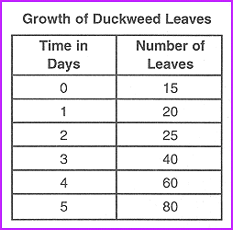

Slide 5
Practice! Use this data to create a line graph.
Temp. (⁰C) | # E. coli after 10 Days
0 | 50
2 | 80
4 | 85
6 | 110
8 | 200
10 | 275
12 | 350
14 | 480
16 | 650
18 | 890
20 | 1300

Slide 6
Water Clarity and Zebra Mussels
Year | Zebra mussels (per m²) | Secchi depth (cm)
1991 | 0 | 90
1992 | 1995 | 110
1993 | 2500 | 118
1994 | 1890 | 155
1995 | 780 | 130
1996 | 500 | 60
1997 | 3200 | 105
1998 | 1490 | 85
1999 | 1000 | 119
2000 | 850 | 65
2001 | 500 | 85
2002 | 2400 | 122
2003 | 560 | 118
2004 | 700 | 90

Slide 7
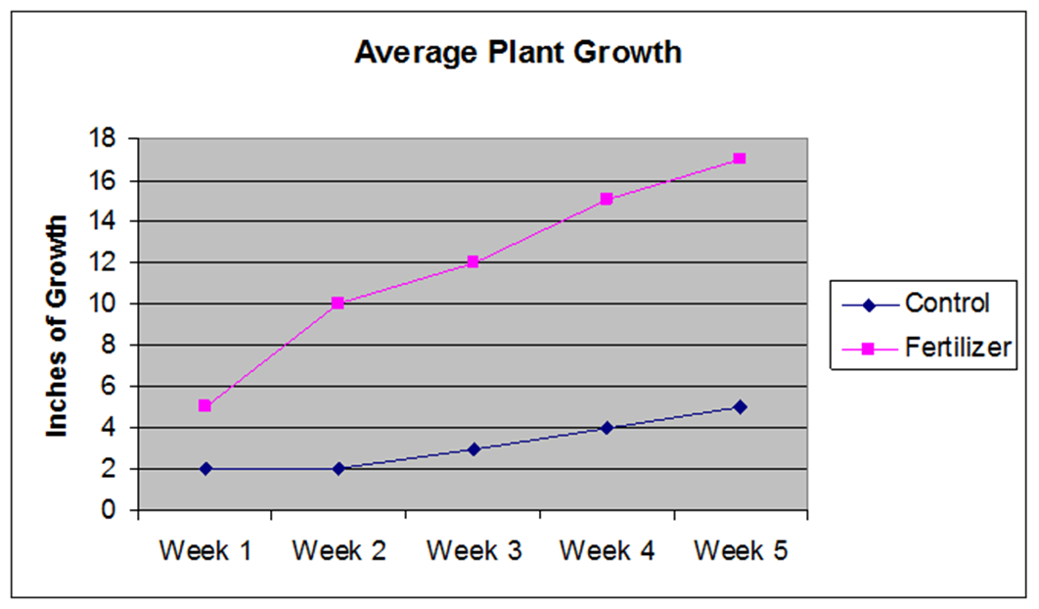
Interpreting Line Graphs
Independent vs dependent variable
Independent variable: ALWAYS on the x-axis
Dependent variable: ALWAYS on the y-axis
Positive or negative correlation
Explain the relationship between variables
Dependent variable
Independent variable

Slide 8
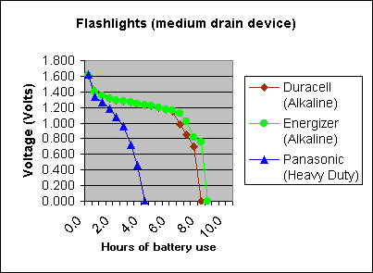
What trend do you see in this data?
Which brand battery would you buy based on this graph? Why?

Slide 9
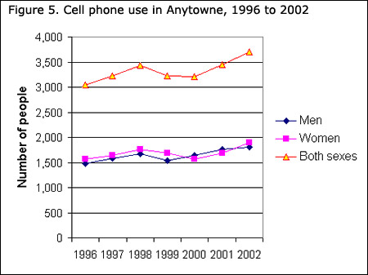
What are the independent and dependent variables?
Is this positive or negative correlation?
What is the relationship between the year and the number of people using cell phones?

Slide 10
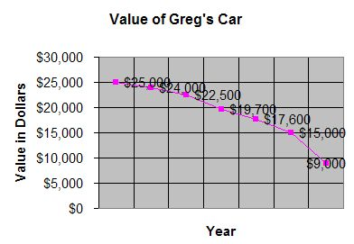
What are the independent and dependent variables?
Is this positive or negative correlation?
What is the relationship between the year and the value of the car?

Slide 11
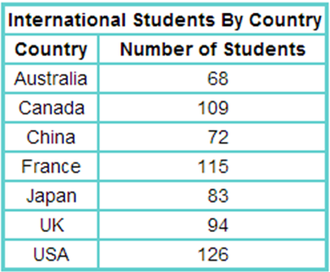
Sneakers Sold for November 2500 at the Shoe Source
Brand Name | Number Sold | Percentage Sold
Adidas | 150 | 25
Nike | 192 | 32
Reebok | 60 | 10
Asics | 108 | 18
Other | 90 | 15

