Slide 1
Development of Atomic Theory

Slide 2
Democritus (Philosopher)

Slide 3
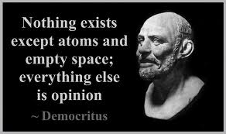
Democritus

Slide 4
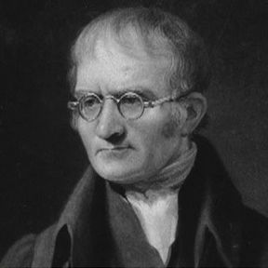
Dalton (Chemist)
1808
Revised atomic theory
Atoms cannot be divided
All atoms of a given element are exactly alike (same size, shape, weight)
Atoms of different elements join to form compounds

Slide 5
Dalton
Now known as the Law of definite proportions: a chemical compound always contains the same elements in the same proportions
Unlike Democritus…Dalton Had Experimental evidence
Dalton’s model: atoms are small, solid, indestructible spheres
Chemical reactions are just atoms being rearranged (combined, separated)

Slide 6
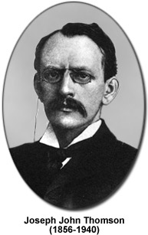
JJ Thomson (Physicist)
1897
Cathode ray experiment
He found that cathode rays were made of negatively charged particles from inside atoms
This showed that atoms could be divided into smaller parts! (electrons)
Thus, he discovered the first subatomic particle!
He called the particle “corpuscles” instead of electrons! Scientists changed the name later.

Slide 7
Cathode-ray Tube Experiment

Slide 8
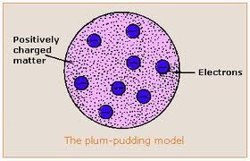
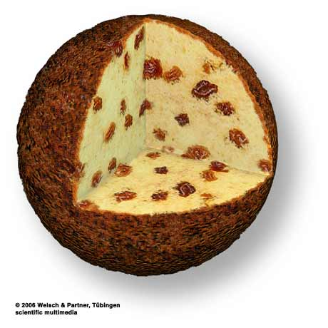
JJ Thomson’s Plum Pudding Model
Electrons (negatively charged) are spread throughout the atom

Slide 9
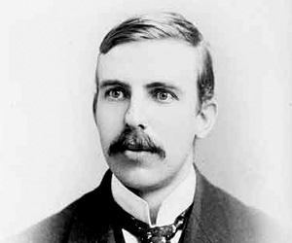
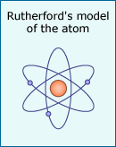
Rutherford
1899
Atoms have a dense, positively charged nucleus
Developed his theory based on the gold-foil experiment
New model of the atom has electrons orbiting the positive nucleus (planetary model)

Slide 10
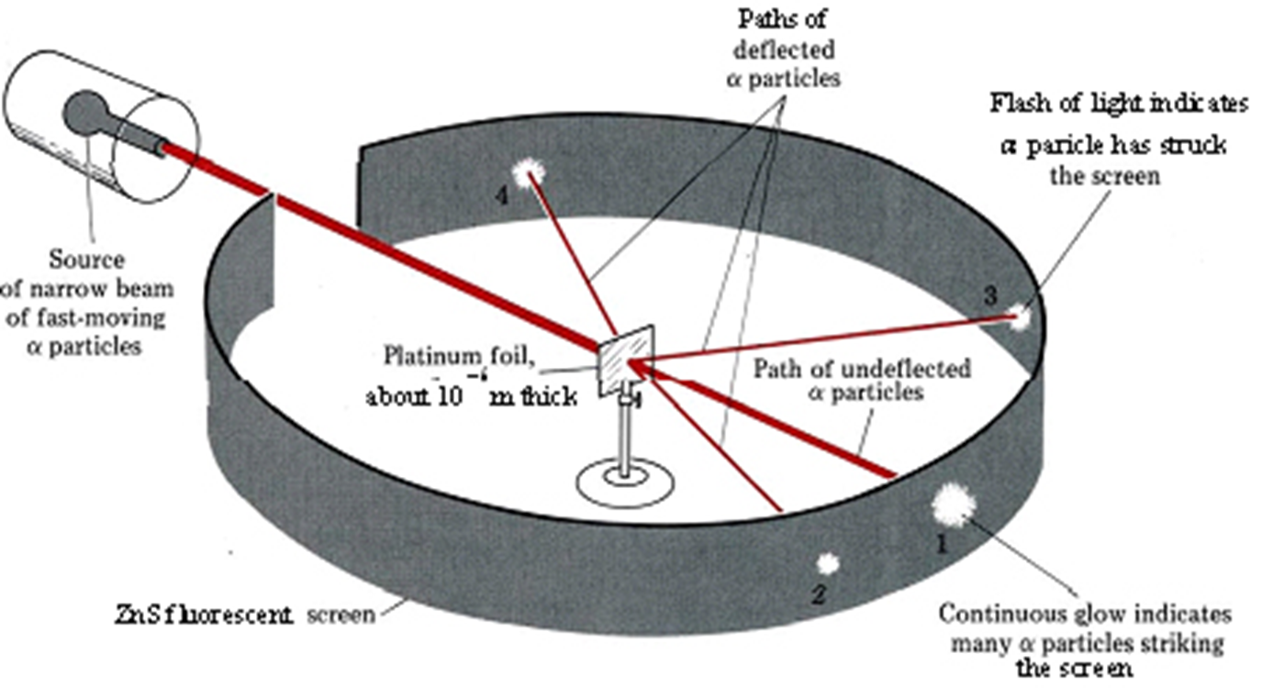
Gold-foil Experiment

Slide 11
“It was quite the most incredible event that has ever happened to me in my life. It was almost as incredible as if you had fired a 15-inch shell at a piece of tissue paper and it came back and hit you.”

Slide 12
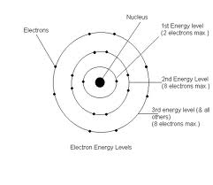
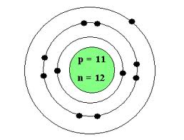
Bohr model
1913
Electrons only in certain energy levels (or shells)
Each level holds a certain number of electrons
“planetary” model of atom

Slide 13
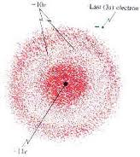
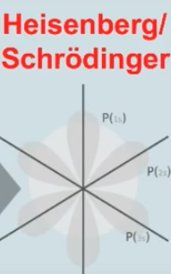
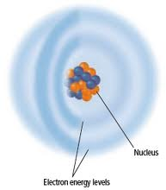
Electron Cloud Model
Developed in 1925 by Heisenberg and Schrodinger
Bohr’s model could not explain all electron behavior
Shows movement of electrons

Slide 14
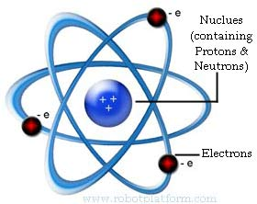
James Chadwick
1932
Discovered the neutron by comparing proton mass to atomic mass

