Slide 1
Compound Formulas and Names

Slide 2
Ionic Compounds
Positive ion (the metal)
Cation
Negative ion (the nonmetal)
Anion

Slide 3
Naming Ionic Compounds
List the metal (cation) first
Just name the element
Nonmetals (anions) are second
Altered name of the element
Change ending to –ide
Examples: NaCl (sodium chloride), CaO (calcium oxide)
What would be the name of MgS?

Slide 4
Practice
Name the following compounds:
LiF
KBr
BaO
AlN
BeS
Ca₂F

Slide 5
Covalent Compounds
Slightly different rules
Name the elements from left to right on the periodic table (ex: name carbon before oxygen)
The second element named will end in –ide (just like in ionic compounds)
Use prefixes to tell how many atoms of an element are in the compound
Ex: Carbon dioxide = CO₂

Slide 6
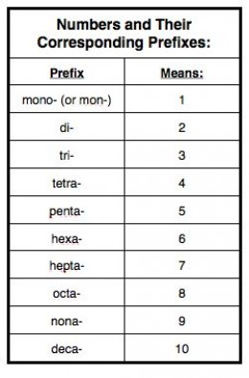
Covalent Compounds
First element:
If there is just one in the compound, it does not need a prefix
Second element:
Numerical prefix before the name
End the name in –ide

Slide 7
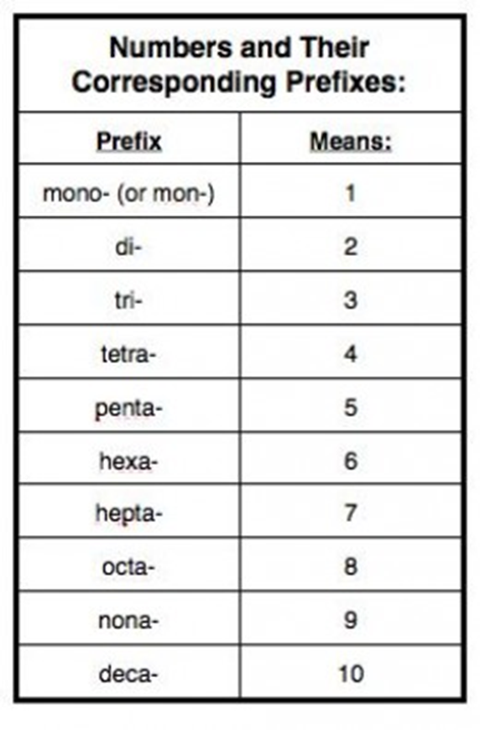
Examples
CO₂ = carbon dioxide
N₂O₄ = dinitrogen tetroxide
BF₃ = boron trifluoride
CO = carbon monoxide
Name the following compounds:
SeO₂
SiI₄
As₂O₅
P₄S₃

Slide 8
Review Questions
Number of Atoms | Prefix
1 | mono-
2 | di-
3 | tri-
4 | tetra-
5 | penta-
6 | hexa-
7 | hepta-
8 | octa-
9 | nona-
10 | deca-
Name the following ionic compounds.
FeI₂
MnF₃
CrCl₂
CuS
Find the charge of the cation in cadmium bromide, CdBr₂.
Name the following covalent compounds:
CO
SO₃
SCl₄
P₄O₁₀

