Slide 1
Chemical Reactions

Slide 2
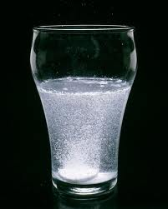
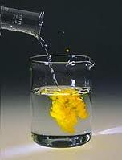
Chemical Reactions
Chemical reactions
Substances go through chemical changes to form new substances
How do we know a chemical change has taken place?
Formation of a gas
Formation of a precipitate (solid)
Release of energy

Slide 3
Key Vocabulary
Reactant- substance that undergoes a chemical reaction
Product- substance formed in a chemical reaction

Slide 4
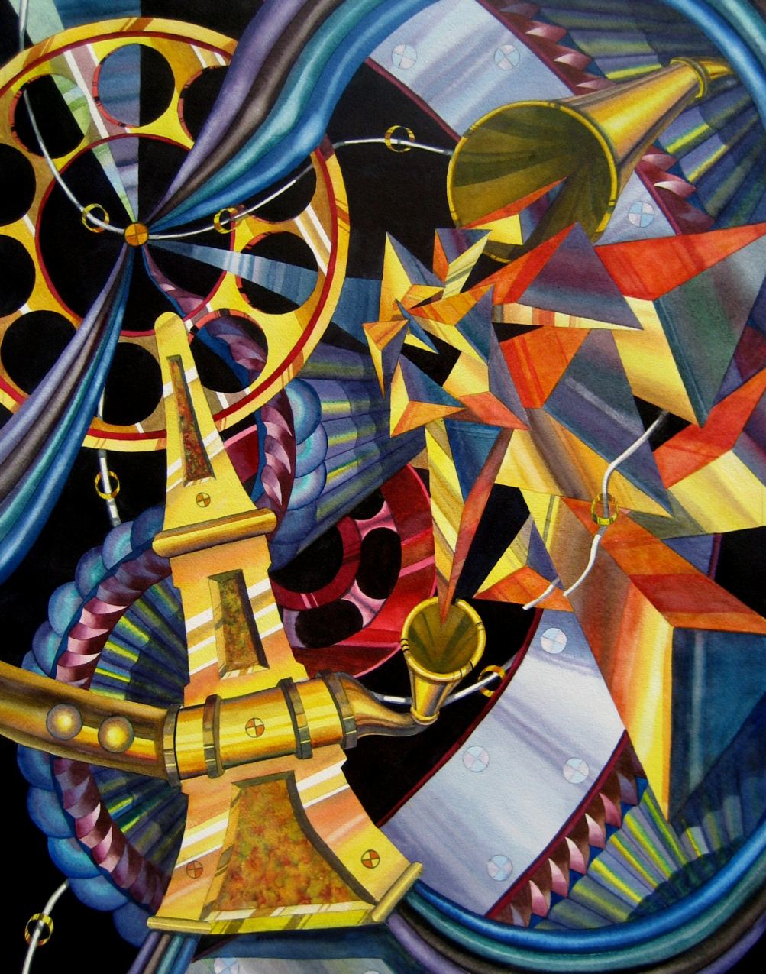
Law of Conservation of Energy
This should sound familiar ☺
Energy cannot be created or destroyed… but it can change forms.
What are some different forms of energy?

Slide 5
Chemical Reactions
Two basic types:
Exothermic
Endothermic

Slide 6
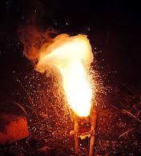
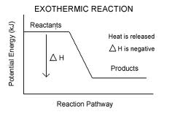
Exothermic Reactions
Energy is released during the reaction
Heat, light, electricity, etc.

Slide 7
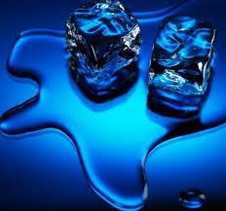
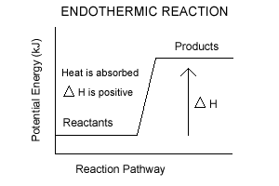
Endothermic Reactions
Energy is absorbed

Slide 8
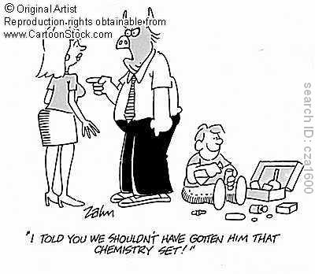
Classifying Reactions
Four types of reactions
Synthesis reaction
Decomposition reaction
Single displacement reaction
Double displacement reaction

Slide 9
Synthesis Reaction
Two or more substances combine to form a new compound
The product is more complex than the reactants
Formula generally formatted like this:
A + B → AB
Ex: 2H + O → H₂O, Na + Cl → NaCl

Slide 10
Decomposition Reaction
Break substances down
Opposite of synthesis reactions
AB → A + B

Slide 11
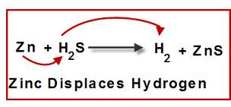
Single Displacement Reaction
One element takes the place of another during the reaction
They appear to switch places
General format: AX + B → BX + A

Slide 12
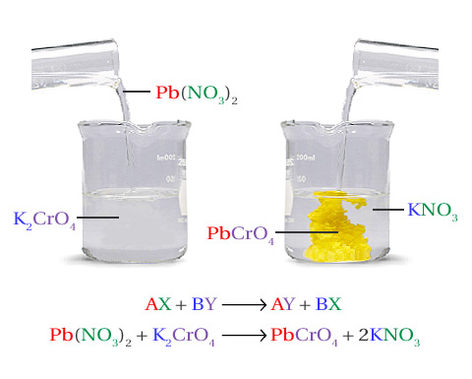
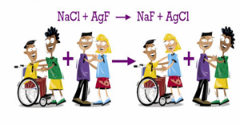
Double Displacement Reaction
Two compounds appear to exchange ions
General format:
AX + BY → AY + BX

Slide 13
Classifying Reactions
PbCl₂ + AgNO₃ → Pb(NO₃)₂ + AgCl
2. NH₃ + HCl → NH₄Cl
AlCl₃ + Na₂SO₄ → Al­₂(SO₄)₃ + NaCl
­­­­4. Zn + S → ZnS
5. Al₂(SO₄)₃ + BaCl₂ → BaSO₄ + AlCl₃
Al₂S₃ → Al + S
H₂SO₄ + Fe → H₂ + FeSO₄
8. Mg(OH)₂ + H₂SO₄ → MgSO₄ + H₂O
­­­9. NaOH + CuSO₄ → Na₂SO₄ + Cu(OH)₂
10. Fe + O₂ → Fe₂O₃

Slide 14
Balancing Equations
Chemical equations are like recipes
They tell us how many atoms of each element are needed for the reaction.
The Law of Conservation of Mass tells us that mass cannot be created or destroyed.
That means that in a chemical equation, there needs to be the same amount of an element on each side (reactants and products).
The equation needs to be balanced.

Slide 15
How do We Balance Equations?
Count the atoms of each element on each side of the equation.
To balance the equation, we can use coefficients (number in front of the element symbol).
We cannot change the subscripts that are already there.

Slide 16
Practice
Mg + O₂ → MgO
How many magnesium atoms do we have?
How many oxygen atoms?
What coefficients can we add to make both sides equal?
Na + MgF₂ → NaF + Mg
N₂ + H₂ → NH₃
Zn + AgNO₃ → Zn(NO₃)₂ + Ag

Slide 17
Balancing Equations
NaCl → Na + Cl₂
H₂CO₃ → CO₂ + H₂O
Na + HCl → H₂ + NaCl
SnO₂ + H₂ → Sn + H₂O
S₈ + O₂ → SO₃

Slide 18
Classifying Reactions Activity
Synthesis Decomposition Single Displacement Double Displacement
For each type of reaction:
Cut and paste examples
Balance equations (some may be balanced already!)
Write the definition of each type of reaction
Omit # 7, 16, 19

