Slide 1
Chemical Bonding

Slide 2
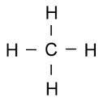
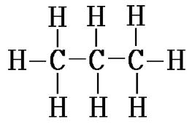

Chemical Bonds
Chemical bonds hold atoms together to make compounds

Slide 3
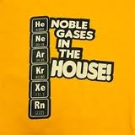
Why do Bonds Form?
Atoms want to have full outer shells
When atoms bond, each atom has a full energy level of valence electrons (just like the noble gases)

Slide 4
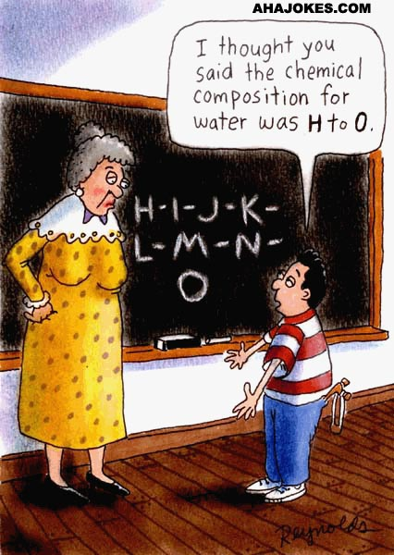
Types of Bonds
Two main types of bonding
  Ionic
  Covalent

Slide 5

What are some things you remember about chemical bonding?

Slide 6
Ionic bonding
Which group(s) do you think will lose electrons? Will this make them positive or negative?
Which group(s) do you think will gain electrons? Will this make them positive or negative?

Slide 7

Ionic Bonds
Atoms of metals tend to lose electrons to form positive ions
Nonmetals tend to gain electrons and form negative ions
Ionic bonds form when one atom gives electron(s) to another atom

Slide 8
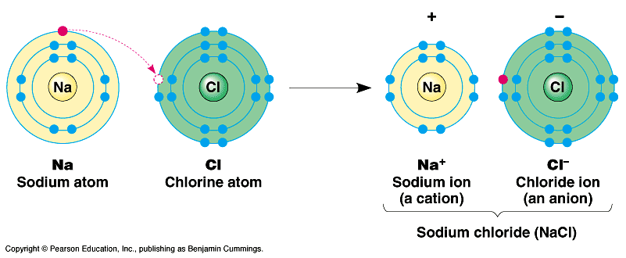
Ionic Bond
Table salt (NaCl)

Slide 9
Oxidation Numbers
The oxidation number is equal to the charge of an atom after it has gained or lost electron(s)
For example, we saw sodium (Na) lose an electron. The oxidation number would be +1.
Chlorine gained an electron. What would be its oxidation number?

Slide 10
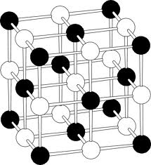
Characteristics of Ionic Compounds
Made from a positive and a negative ion (such as Na⁺ and Cl⁻)
  The overall charge is neutral!
Conduct electricity when melted or dissolved in water
  Ions in the liquid state can move more freely
High melting and boiling points
Usually solid at room temperature
Strongest bonds!

Slide 11
Practice
For each of the following:
  Draw Lewis dot structure
  Oxidation numbers
  Show electron transfer
  Write the formula
Magnesium + Oxygen
Lithium + Fluorine
Calcium + Oxygen
Magnesium + Chlorine

Slide 12
Poster
Element Name and Symbol
I Can Bond With…
(List and draw Lewis dot structures for bonds with 4 different elements)
I am reactive because….
My oxidation number is…..
Bohr Model
•
•
Ex
Lewis Dot Model

Slide 13
Before You Leave…
What is one thing you learned today?
What is one question you still have?
What is one thing you already know (or can predict) about covalent bonding?

Slide 14
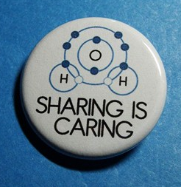
Covalent Bonds
Formed by atoms sharing electrons
Usually formed between nonmetals
Weaker than ionic bonds

Slide 15

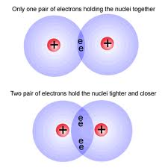
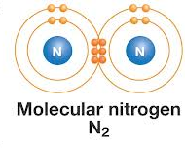
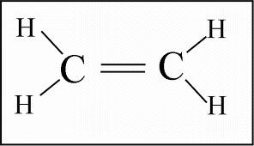
Characteristics of Covalent Bonds
Low melting and boiling points
Do not conduct electricity
Can be solid, liquid, or gas
Can share more than one pair of electrons
  Double or triple bond

Slide 16
Drawing Covalent Bonds and writing their formula
4 steps to success!!
Draw the Lewis Dot structure for the elements
Pair up unpaired electrons by circling them – adding more elements if needed
Redraw the structural formula with lines to represent bonds
Count the number of each type of element and write the formula

Slide 17
Covalent Practice - together
Hydrogen and Hydrogen
Chlorine and Chlorine
Chlorine and Hydrogen
Hydrogen and Oxygen
Nitrogen and Hydrogen
Carbon and Hydrogen
Oxygen and Oxygen

Slide 18
Independent Practice
H and Br
P and Cl
S and O
Si and Cl
C and O

Slide 19
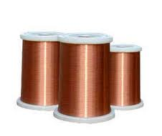
Metallic Bonds
Bonds between metal atoms
Attraction between nucleus of one atom and the electrons of nearby atoms
Energy levels overlap so electrons move freely between atoms

Slide 20
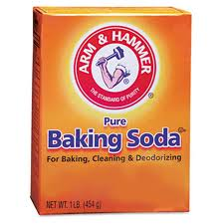
Polyatomic Ions
A group of atoms that have a charge.
Contain both ionic and covalent bonds
Have a positive or negative charge overall
  Example: baking soda (NaHCO₃) is made from a bond between Na and a polyatomic ion (HCO₃-)

Slide 21
Macromolecules
(aka Biomolecules)
Organic compounds
  Contain carbon
  Building blocks of life
  Carbohydrates (sugars)
  Lipids (fats/oils)
  Proteins
  Nucleic acids

Slide 22
Quick Review
Identify the following bonds as either ionic or covalent, draw the Lewis dot structures, and write the oxidation number (if applicable).
  H and N
  K and O
  Li and F
Name 3 types of bonds and note which type of molecule comprises each (metals or nonmetals)
List the 4 biomolecules.

