Slide 1
Atomic Structure

Slide 2
Key Vocabulary Terms
For each word listed below, make a “concept card” that includes the term, a definition (in your own words!), a picture/diagram (if applicable), and a sentence using the word.
Electron, nucleus, proton, neutron, atomic number, mass number, isotope
Definition (in your words)
Picture/diagram
Write a sentence using the word
(Back)
Vocab word
(Front)

Slide 3
What Are Atoms Made Of?
Think back to atomic theory
Thomson said atoms have negative particles (electrons)
Rutherford discovered the nucleus of the atom
So, we know that atoms are made of at least two different types of particles (positive and negative)

Slide 4
3 Main Subatomic Particles
Atoms are made of protons, neutrons, and electrons
These particles differ in mass, charge, and location
What do you already know about each particle?

Slide 5
1.67 x 10⁻²⁷ kg
1.67 x 10⁻²⁷ kg

Slide 6
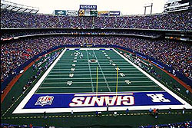
Nucleus
Most of the mass of an atom is in its center
This includes the protons and neutrons
The diameter of an atom equals more than 10,000 times the diameter of its nucleus!
If the nucleus is represented by a ping pong ball, about how large will the atom be?

Slide 7
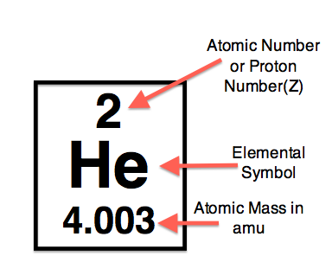
Atomic Number
The atomic number of an element equals the number of protons in its nucleus
Remember, this is usually (but not always!) equal to the number of electrons as well!

Slide 8
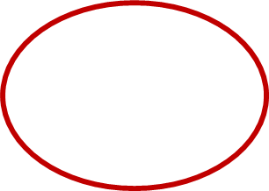
Mass Number
The mass number equals the number of protons plus the number of neutrons in an atom’s nucleus.
Remember, electrons have virtually no mass so they do not factor into this calculation!

Slide 9
Individual Practice
How many protons, neutrons, and electrons are in an atom of…
Carbon (C)
Nitrogen (N)
Tungsten (W)
Gold (Au)
Zirconium (Zr)

Slide 10
Elements
An element is the smallest unit of a substance that has all the characteristics of that substance
Ex: carbon, oxygen, gold, lithium
An element is defined by the number of protons in its nucleus
Ex: Hydrogen always has one proton

Slide 11
How many Electrons?
Each element has a specific number of protons in its nucleus- this number never changes.
The number of protons usually is equal to the number of electrons
This results in an overall charge of 0
What happens if an atom has more electrons than protons?

Slide 12
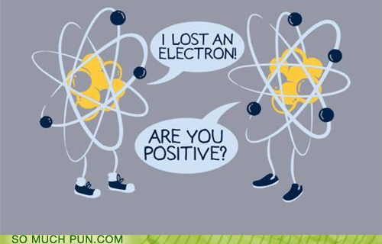
Ions
An ion is a charged atom
This means that the number of electrons is not equal to the number of protons
More electrons than protons = negative charge
Fewer electrons than protons = positive charge
Naming ions

Slide 13
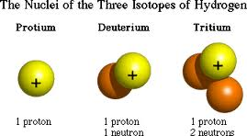
Isotopes
Why do the mass numbers have decimal places?
You cannot have 0.03 protons in a nucleus!
The mass number is an average.
The number of protons is always the same for a given element, but number of neutrons may vary.
An isotope is an atom that has a different number of neutrons than most atoms of the same element.
Heavy WATER!

Slide 14
Calculating Average Atomic Mass
The atomic mass represents the mass of most atoms of a given element.
A weighted average
How do we calculate average atomic mass?
Find the relative abundance of each isotope
Multiply the mass of each isotope by its relative abundance.
Add these values together to get the weighted average.

Slide 15
Average Atomic Mass
Rubidium has two common isotopes, ⁸⁵Rb and ⁸⁷Rb. If the abundance of ⁸⁵Rb is 72.2% and the abundance of ⁸⁷Rb is 27.8%, what is the average atomic mass of rubidium?
Average atomic mass = (85 x 0.722) + (87 x 0.278) = 85.56 amu
*The average atomic mass is closest to the mass of the most common isotope!*

